Slide 1
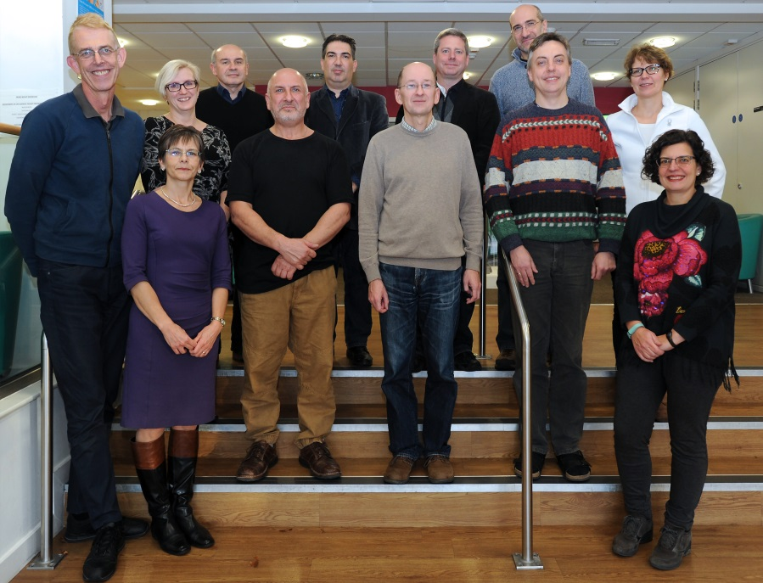
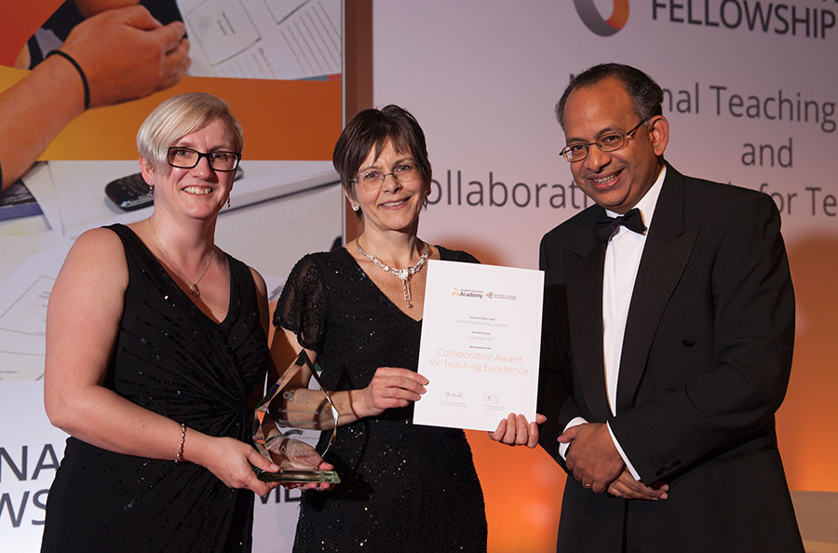
Integrated Programme Assessment (IPA): Reduced Assessment and Better Graduates
CATE WINNERS 2016
Mariann Rand-Weaver
Pro-Vice Chancellor Education

Slide 2
HE sector context
Learning Outcomes – transparency of how students demonstrate achievement
UK/international interest in IPA driven by:
- concerns about over-assessment
- need for authentic assessments
- “we test what is easy to test…..”
- standards based assessment
- sustainable assessment

Slide 3
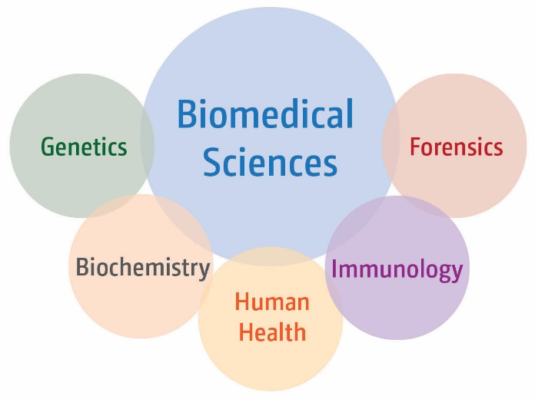
Drivers for change (2010)
Heavy assessment burden
Increased student numbers
Many low-credit pieces of assessment
Improve graduate attributes
Application of knowledge
Develop range of skills
In silo learning
Senate Regulations (2009)
-
uncoupled
teaching and assessment

Slide 4
Senate Regulation changes
From:
… must normally undertake modules to a value of at least 120 credits at each level…
To:
…A normal period if study will be approved for each programme…Each year of full-time study shall normally be equivalent to 120 credits of assessment…

Slide 5
Integrated Programme Assessment (IPA): teaching and assessment uncoupled
Module
T
T
T
T
T
A
A
A
A
A
T
T
T
T
T
A
A
A
Separating study and assessment reflects real life – we integrate information from many sources to solve a problem

Slide 6
IPA - Level 5
Assessment
Synoptic Exam 2
(20)
Biomedical Sciences Exam 2
(20)
Professional Skills
(20)
Primary Literature Interrogation and Synthesis (20)
Data Evaluation and Reporting
(20)
Data Analysis, Interpretation and Presentation
(20)
Study
Critical Thinking
(5)
Career
skills
(15)
Molecular and Cellular Biology
(20)
Genetic Engineering and Immunobiology
(20)
Principles of Human Disease
(20)
Analytical Biochemistry(20)
Medical Biochemistry (20)
Metabolic Regulation (20)
Genetics & Development (20)

Slide 7
What we achieved
Reduced summative assessment burden by 2/3
Designed meaningful assessments that develop:
critical and analytical thinking
application of knowledge
independent and reflective learning
Give all students the same learning/development opportunities
Improved student experience and outcomes

Slide 8
Student Awards Data
Pre-IPA
Post-IPA
Degree outcomes improved using the integrated assessment approach compared to the modular programme.

Slide 9
Closing the Attainment Gap
2012-2013 | 2015-2016
12.5% | 7.5%
-5%
Pre-IPA
Post-IPA
Attainment gap reduced using the integrated assessment approach compared to the modular programme.

Slide 10
Graduate Level Outcomes
Pre-IPA
Post-IPA
Positive graduate level outcomes increased; negative outcomes decreased

Slide 11
Students feel better prepared for employment
Pre-IPA
Post-IPA
Biomedical Sciences graduates feel better prepared for employment than Department of Life Sciences graduates

Slide 12
NSS – Assessment and Feedback
 | 2013 | 2015
Biosciences | 73% | 79%
Brunel | 72% | 71%
Sector | 74% | 76%
+6%
-1%
+2%
Pre-IPA
Post-IPA
National subject ranking increased from 28th to 8th

Slide 13
IPA in five easy steps
What is the purpose of the programme – who is it for? Aim
What do we want graduates to know; be able to do; skills/competencies? Learning Outcomes
What assessments are needed/appropriate to demonstrate learning outcomes are met? Assessment Strategy
How are students best supported to be successful in assessments? Teaching Strategy
What content needs to be covered, in what sequence, by whom, etc. Delivery

Slide 14
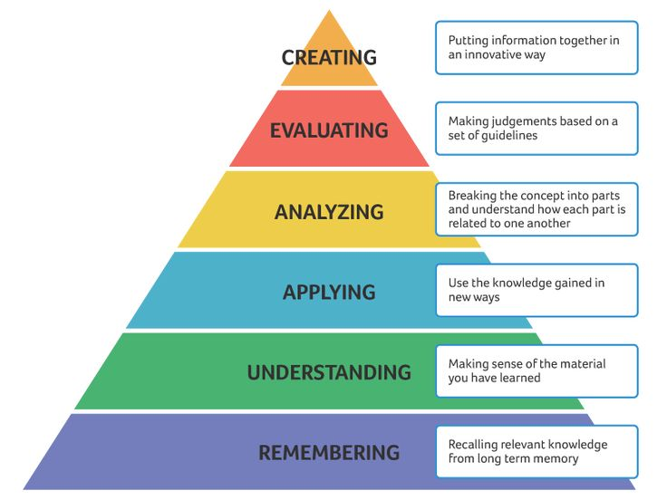
Assessment focussed on skills
Skills
Subject Knowledge, Understanding Integration
Communication
Analysis/ Evaluation
Professional development
Level
6
Level
5
Level
4

Slide 15
Assessment focussed on skills
Skills
Subject Knowledge, Understanding Integration
Communication
Analysis/ Evaluation
Professional development
Assessment
Subject specific and synoptic exams
Presentations Scientific reports and papers
Literature Data Problem Solving
Portfolios
Final Year Project
L | Communication
4 | The ability to communicate basic scientific topics Report
5 | The ability to communicate scientific data and literature Journal manuscript
6 | Effectively communicate complex scientific information Dissertation

Slide 16
Coherence within and between levels
Coherence
Level 6
Level 5
Level 4
Agder University 16 October 2017

Slide 17
Practical Skills: Microscopy
Clinical scenario: patient suffering from abdominal pain
Abdominal pain could be caused by:
a) histological changes b) unusually high number of bacteria normally present in the gut c) bacterial or fungal species not normally present in the gut
Students have to:
- assess histology images of the digestive tract - evaluate Gram staining results - evaluate cell counts
and establish what might be the cause of the patient’s problems

Slide 18
IPA - Level 4
Assessment
Synoptic Exam 1
(20)
Biomedical Sciences Exam 1
(20)
Practical Skills: Molecular Analysis
(20)
Practical Skills: Biochemical Analysis
(20)
Practical skills: Microscopy (20)
Research Skills & Communic-ation
(20)
Function and histology of the digestive tract
Skills
Differentiation of bacteria
Study
Cell counting
Skills
Critical Thinking
(5)
Research skills
(15)
Practical skills
(20)
Biology of the cell
(40)
Biochemistry
(20)
Anatomy & Physiology (20)

Slide 19
Requirements for IPA
Regulations that accommodate separation of teaching/study and assessment
Collegial and team/based approach
Main Challenge / Main Strength
3. Vision of what is to be achieved
4. Plan everything (coordinators/marking/moderation)

Slide 20
Benefits
Staff
Assessment burden is reduced
Marking is shared
Teaching has become a ‘community property’
Students
Fewer more interesting assessments
Formative activities supports learning
Recognise graduate attributes
Institutional
Highlighted as good practice by professional bodies
Improved programme development framework
Students as partners

Slide 21
Recognised Programme Developers
RPDs
Staff with practical experience in programme design
Have undergone training
Required to be on a design team to support development
Chair programme approval events
Highlighted by QAA as an aspect of good practice

Slide 22
Re-thinking assessment
What are the challenges and opportunities? Joint degrees
What assessment methods do you use? What could you use? Authentic assessments
Sustainable assessment?
fit for purpose in the present
gives students skills that can be built on in the future
facilitates life-long learning

Slide 23
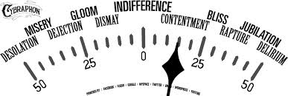
Happy-o-meter of IPA approach
http://www.brunel.ac.uk/about/education-innovation

