Slide 1
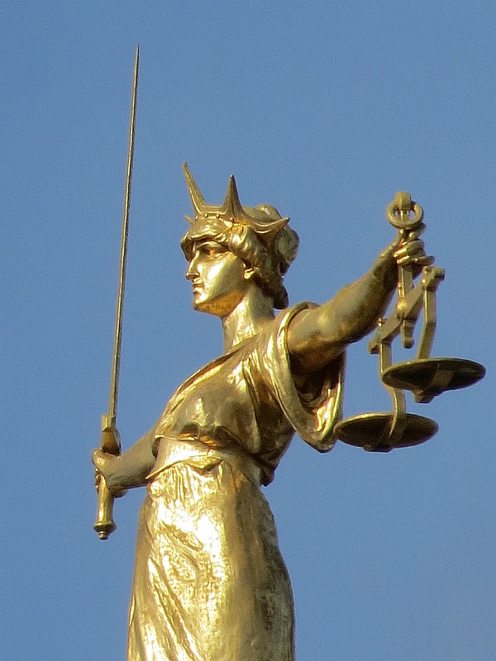
Making the Case:
Embedding Information Literacy
in a Law Module
Susan McGlamery
Academic Support Librarian, SLC
University of West London
Susan.Mcglamery@uwl.ac.uk

Slide 2
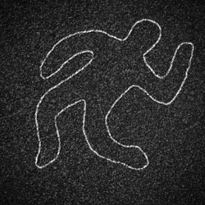
Information Literacy (IL) and SCL A brief history of embedding IL in SCL modules
UWL Library KPI: “Campus based students provided with information literacy embedded in to their curriculum at levels 3, 4 and 7”
SLC IL embedded sessions:
general sessions, not tied to an assessment
Research methodology, specific sources, referencing
Practical Law, Literature Bingo, Body in the Library
Targeted sessions, relevant to an assessment
Andreykuzmin (no date)

Slide 3
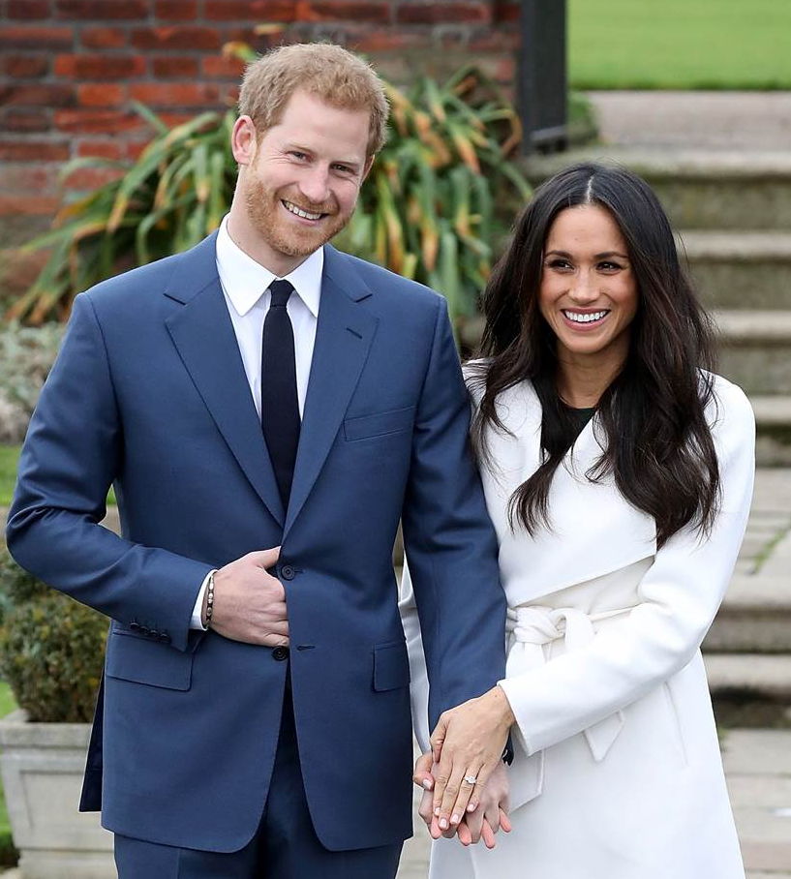
Targeted instruction: methods
Locating primary & secondary sources relevant to a specific topic
Lecture + demo (classroom)
L4: Criminal Law, ELS
L5: Equity, EU Law, Serial Killers
Problem-based instruction (PC room)
L4: Constitutional & Administrative Law
L6: Community Legal Advice
L7: Practical Legal Research (LPC)
Getty Images (2017)

Slide 4
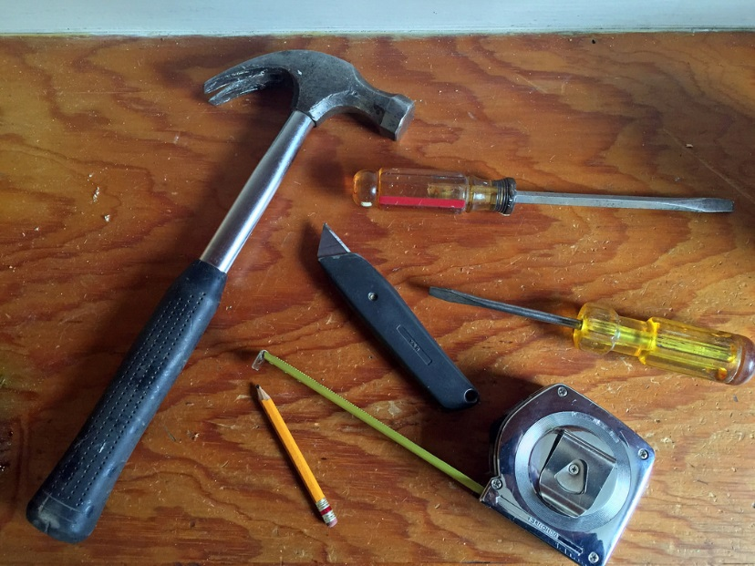
Personalised Learning: L3, 1st semester
80+ students: LLB, Criminology, Sociology
Learning outcomes:
To demonstrate an understanding of different styles and means of communication within academic and formal contexts
To demonstrate common study skills within a subject specific context
To identify academic sources appropriate to the given task
CappiT (2017)

Slide 5
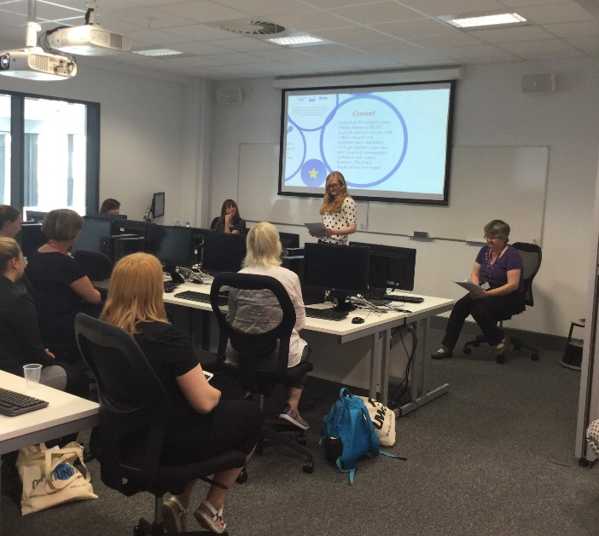
IL components of PL module
3 sessions
Introduction to searching (assessed, 10%)
Using databases (assessed, 10%)
Referencing (assessed, 10%)
Delivery:
Lecture: instruction, demo online resources (2 hours)
Seminar: Students complete exercises online in PC room (1 hour)
Krol (2017)

Slide 6
Student feedback: informal (Poll Everywhere)
“How confident do you feel in finding information for your academic work?”

Slide 7
Academic Performance: L3, 2nd semester
Learning outcomes:
To construct an argument in an academic context
To position yourself within an argument
To apply a range of academic skills and techniques to a real case scenario
Method: study one law case throughout the semester
Gain experience in reading a case (structure, language)
Learn how to develop an argument, supported by evidence
16 weeks: lecture + seminar
7 Assessments: 1 MCQ + 6 short essays on various issues in the case

Slide 8
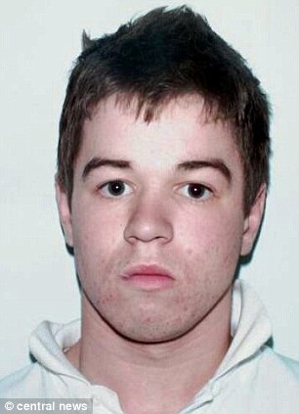
Selecting the case
Criminal law
Relatable victims and offenders
Interesting procedural history
R v Hallam (Sam)
Gang murder (maybe) in London
Victim, offenders and witnesses are 17- 21 y.o.
Miscarriage of justice (3 Court of Appeals cases, campaign, media attention)
Key evidence on defendant’s mobile phone
Central News (2004)

Slide 9
Initial Challenges
Logistics:
Class size (80+), lecture room: not conducive to engagement
No hands-on, so IL components were primarily discussion and demo
Case method:
Impart a distinctive habit of thinking, understand the legal process (Stolker, 2014, pp. 149-164)
Not as relevant to Criminology, Sociology
Advantage: expanding case discussion to embrace larger issues
Role of ASL as co-lecturer
time, marking

Slide 10
Example: eyewitness evidence (week 2)
Issue: Are the Hallam eyewitnesses reliable?
Legal standard: What are the hallmarks of a credible witness?
IL: use Lexis/Westlaw to discover primary and secondary materials, as well as general textbooks, to find the relevant legal standard (and how it’s applied)
The Case: examining the text of the case, we review the various statements of the two key eyewitnesses
Engagement: eyewitness game
Assessment: Summary of the strengths and weaknesses of the evidence of 2 key witnesses in the Case (400 words, 10% of final mark)
Would you be a reliable eyewitness?
http://www.bbc.co.uk/guides/zcc6sg8

Slide 11
Example: Criminal Case Review Commission (week 8)
IL: finding information on: what is the CCRC, it’s role, the process, statistics on how many cases are handled, and any commentary on the CCRC’s work
The Case: Examining the text of the Case, we review the role of the CCRC and how it impacted on the outcome of the Case.

Slide 12
Strengths
Just to let you know, just for information, all A4's have now been marked, and you will be delighted to know that the standard was remarkably high...I think the approach we are adopting is definitely bearing fruit, so many congratulations
all the best, Mike
In-depth reading of the case: students improved in close reading, finding evidence to back up their arguments
Greater familiarity with how to use legal databases, including legal dictionary, locating relevant authority and commentary
Single case provided a framework
Most students were interested in the case

Slide 13
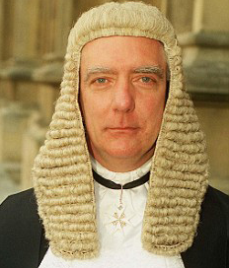
Weaknesses to be addressed
Trial: Hone, J
More student-led discovery
Finding resources external to the case
For seminars, arrange for PC room
More engagement
Poll software to elicit more opinions, discussion?
Too closely tied to the 2012 case?
Chronology based on events would avoid bias
Universal Press (no date)
CA 2007:
Latham, LJ
CA 2012:
Hallett, LJ
Topfoto (2004)
UPPA (no date)

Slide 14
Impact: MEQ data from the “Library” question, semester 2
ALL levels | L3 | L4 | L5 | L6 | L7
SLC | 85% | 88% | 87% | 85% | 81% | 83%
Average | 80% | 80% | 80% | 79% | 81% | 83%
School change since 16/17 semester 2
 | 2016/17 semester 2 | 2017/18 semester 2
SLC | 74% | 85% | +11
Average | 78% | 80%

Slide 15
Questions?
Susan McGlamery
Academic Support Librarian, SLC
susan.mcglamery@uwl.ac.uk

Slide 16
References
Stolker, C. (2014) Rethinking the Law School. Cambridge: Cambridge University Press.

Slide 17
References
Stolker, C. (2014) Rethinking the Law School. Cambridge: Cambridge University Press.
Photo Credits
Andreykuzmin (no date) Chalk outline of dead body on asphalt road. Available at: https://www.dreamstime.com/royalty-free-stock-images-chalk-outline-dead-body-asphalt-image27900609 (Accessed: 4 April 2018).
CappiT (2017) Carpentry tools. Available at: https://www.flickr.com/photos/34637679@N04/35765352600 (Accessed: 4 April 2018).
Central News (2004) Sam Hallam. Available at: http://www.bbc.co.uk/news/uk-england-london-14331538 (Accessed: 4 April 2018).
Getty Images (2017) Meghan Markle Prince Harry official engagement photos. Available at: http://www.vogue.co.uk/article/prince-harry-and-meghan-markle-engaged (Accessed: 4 April 2018).
Krol, E. (2017) Ian Carter Room [photograph].
Topfoto (2004) Lord Justice Latham. Available at: img.pars04.fr.topfoto.co.uk (Accessed: 4 April 2018)
Universal Press (no date) No sympathy: Judge Richard Hone. Available at: http://www.dailymail.co.uk/news/article-1228202/Doctor-Edward-Erin-jailed-years-spiking-pregnant-lovers-drink-make-lose-baby.html (Accessed: 4 April 2018)
UPPA (no date) Lady Justice Hallett. Available at: http://obiterj.blogspot.co.uk/2017/05/lady-justice-hallett-and-jury.html (Accessed: 4 April 2018).
UWL (2018) Why UWL. Available at: https://www.uwl.ac.uk/why-uwl (Accessed: 4 April 2018).
UWL (2017) Michael Derks. Available at: https://www.uwl.ac.uk/users/Michael-Derks (Accessed: 4 April 2018).

