Slide 1
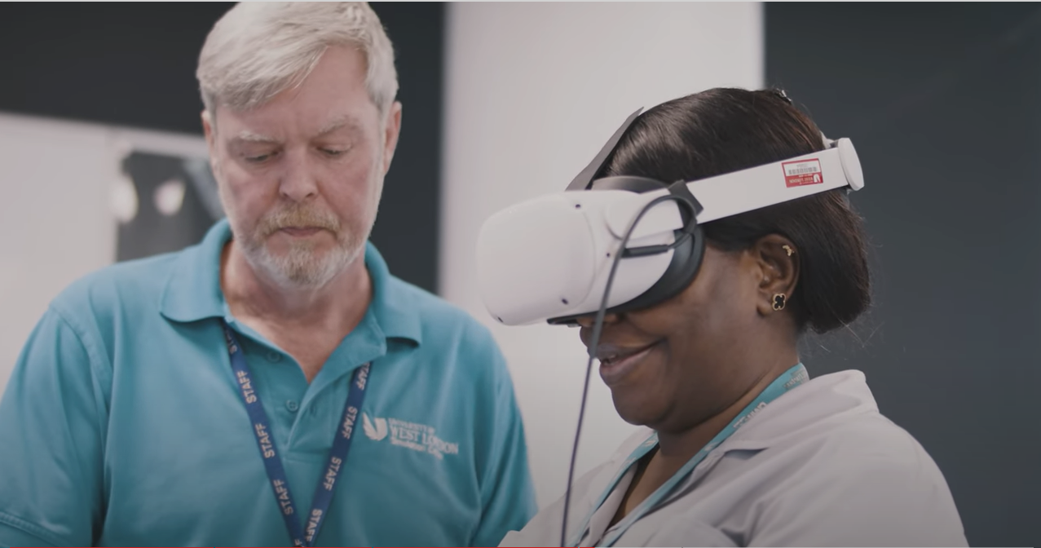
Implementation of Virtual Reality in UWL FLEX Blended Model of Pedagogy
PGDIP, April 22- Sciences Underpinning Evidence Based Nursing Practice
MSc Blended Learning, Sept 22- Evidence-Based Nursing Care- Art and Science
Neus Carlos Martinez, MSc., RN, Senior Lecturer - neus.carlos@uwl.ac.uk
Charlotte Bramanis, MSc., RN, Senior Lecturer - charlotte.bramanis@uwl.ac.uk
Behnam Jafari Salim, Learning Designer and Digital Simulation Tech - behnam.jafarisalim@uwl.ac.uk

Slide 2
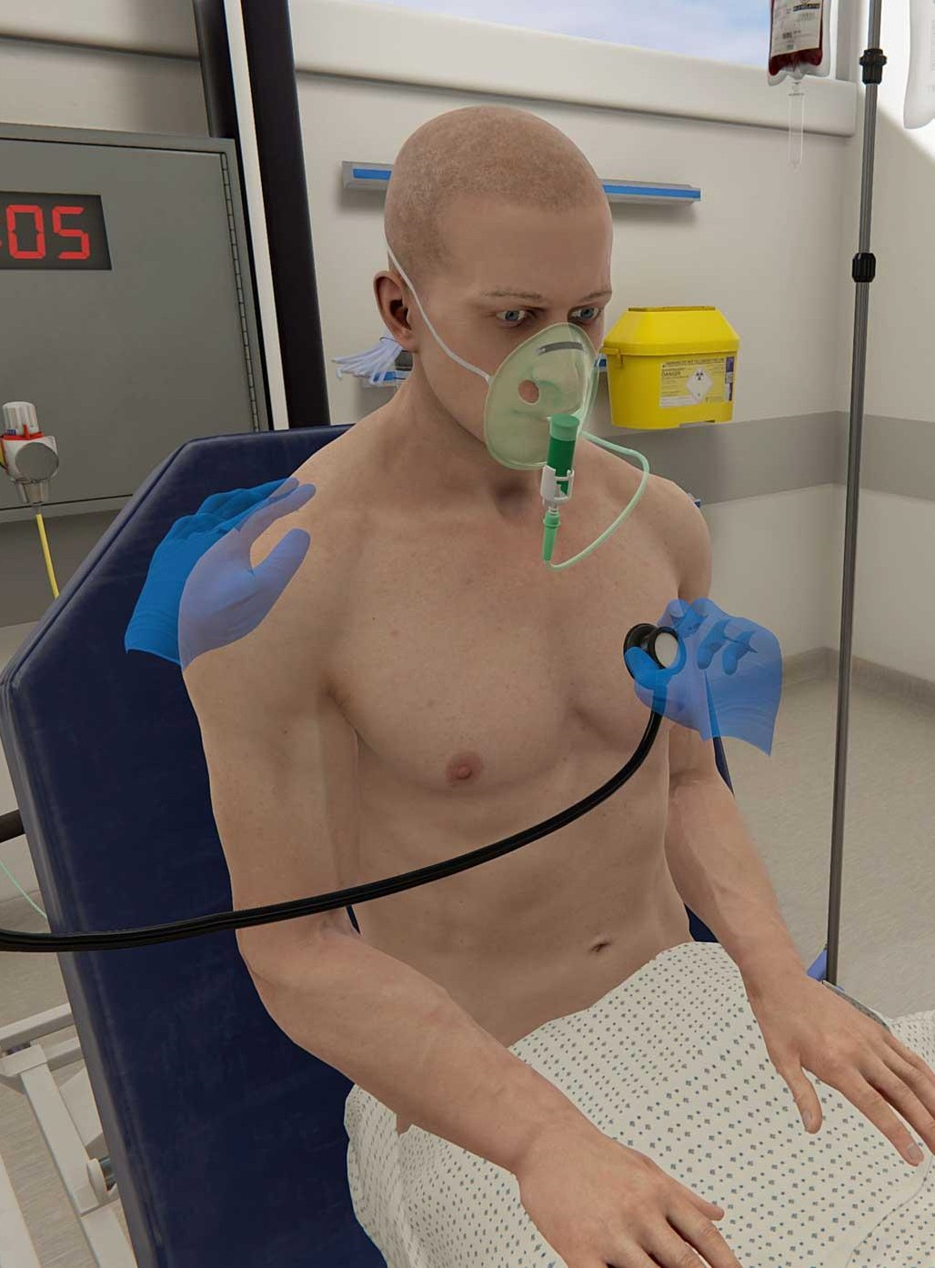
Why are we embedding VR in the blended learning programme?​
Providing measurable and flexible quality simulation in synchronous and asynchronous learning
Addressing the gap between theory and practice​
Self-paced learning and addressing different learning needs
Providing a safe environment to practice clinical reasoning and decision making​
Preparing students for success in a modern work force
Alternative assessment delivery

Slide 3
Key features
Personal, intelligent feedback supported by evidence-based practice
Access to comprehensive data analytic dashboard for students and staff
AI driven patient behaviour, adaptive conversation and patient condition determined by student interaction​
Accessible for synchronus and asynchronus learning with minimum supervision

Slide 4
Patient Communication
Decision Making
and Guidelines
Nursing Assessment Process
Escalation and
Handover
Some of the skills developed using VR
Diagnostic Tools
Patient
Monitoring
Result Interpretation
and Clinical Reasoning​
Reflection

Slide 5
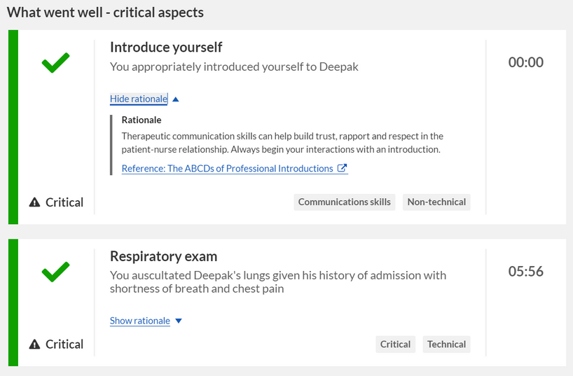
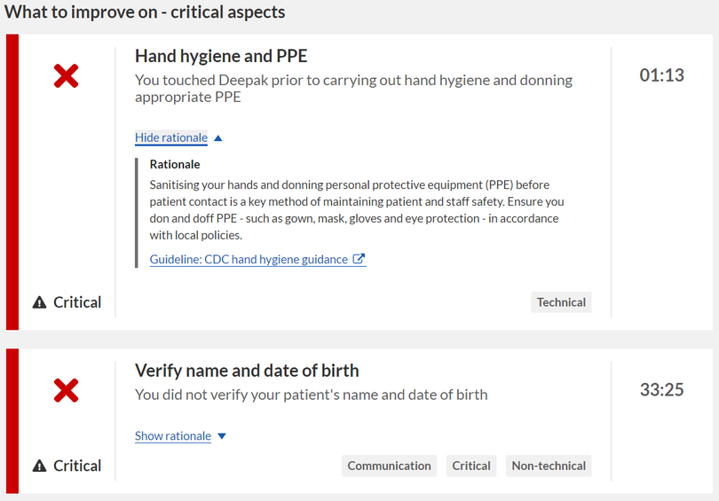
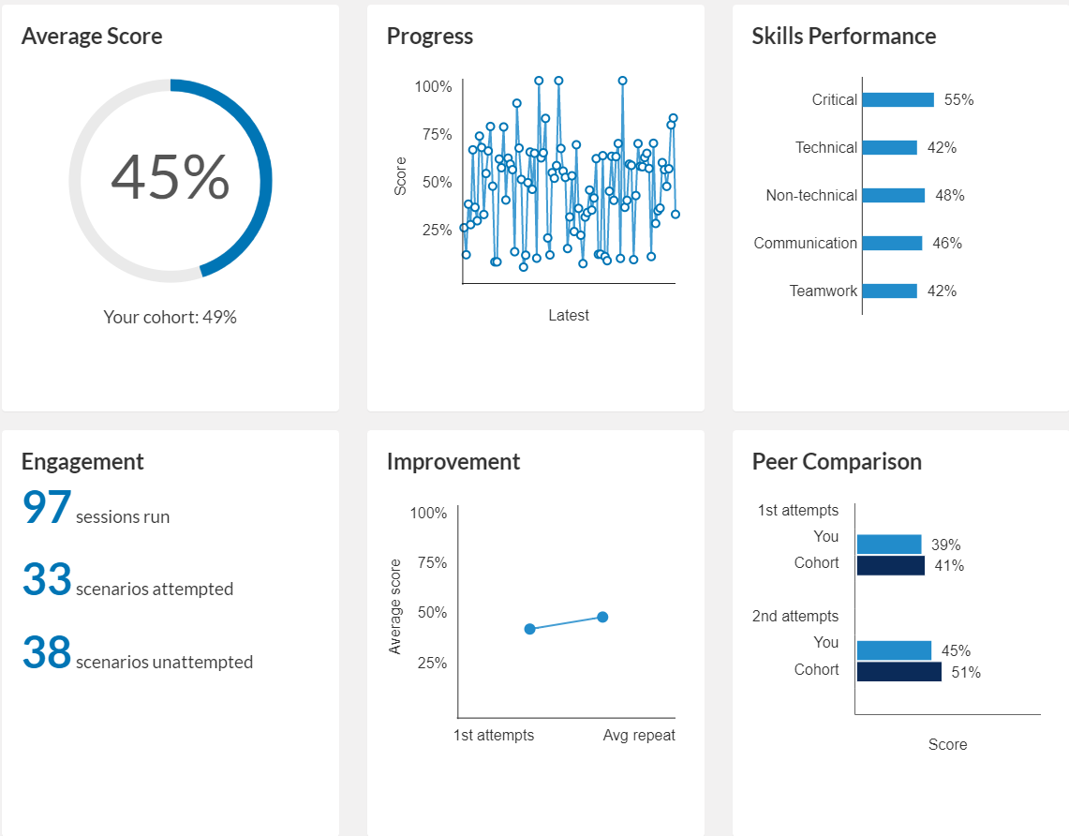
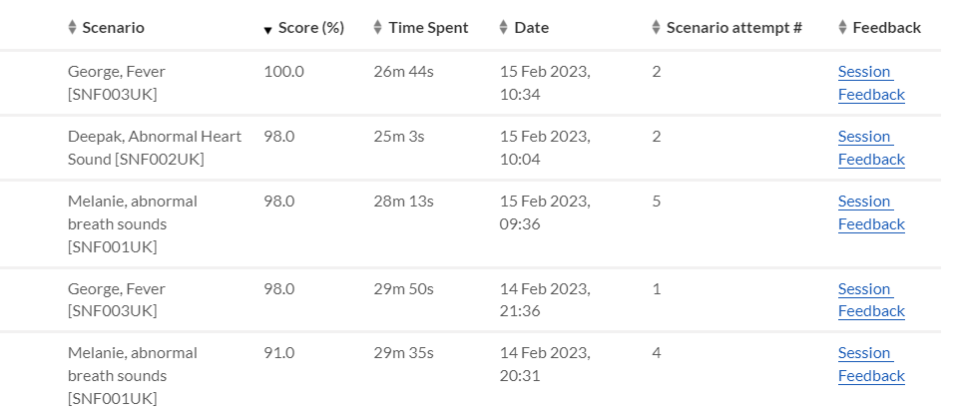
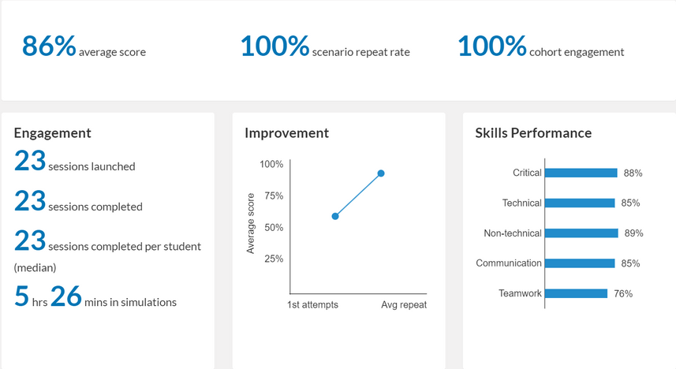
Individual Student feedback and analytic dashboard

Slide 6
Activity Examples
Investigate
Apply
Consolidate
Students are asked to do a self-directed session on a VR case scenario and create a nursing care plan that is discussed in class during the 'Apply' session.
The academic or one of the students launch the scenario while sharing their screen. Students as a group interact during each step of assessment and explore the clinical reasoning and decision-making process.
In groups, students discuss their findings of the VR case scenario and compare their NEWS results and SBAR handovers.
Students are asked to do a self-directed VR session and write a reflection on their assessment based on the system generated feedback.
Students are asked to complete a quiz based on a VR scenario.
Students are directed to do a systematic A-E assessment and feedback will be given by academics based on the student activity report.
Students are asked to explore a scenario and review patient medication. On the discussion board medication information, its management and protocols are discussed.

Slide 7
Assessment
Students undertake a hybrid OSCE (Objective structured clinical examination) approach to demonstrate their competency in performing a systematic ABCDE assessment and practical skills in their formative and summative assessments.
VR-OSCE
Clinical skills and Documentation

Slide 8
Lessons Learned:
Some students find it difficult to install and access the software
Students initially find patient assessment process challenging
Some students can become aware of how to trick the system
Lack of engagement with the VR platform
VR does not replace practice
Introducing VR induction sessions
Provide access on platforms such as
Consider using tools such as SOAP note, NEWS chart
Use a variety of methods to monitor student activities
Consider linking activities
Introducing competition and fun challenges
VR is effective in developing communication, decision-making skills and teaching systematic assessment however Students still need hands on practice-time to learn clinical skills

Slide 9
Students Feedback and Comment
"From the feedback I can see areas I did well and areas I need to improve and this helps my confidence and knowledge a lot."
"It can encourage engagement with the topic in a safe way. encourages critical thinking, communication and teamwork”
"Opportunity to repeat a scenario over and over again. In you develop learning and build up your confidence."
"It was unbelievable to be able to communicate. It made it feel real."
"I had difficulty accessing and installing the software"
"Main challenge was working through scenarios getting use to choosing the right assessments in the right order that trying not to miss anything and knowing what to look for and monitor."
"Some scenarios are too challenging."

Slide 10
THANK YOU
VR footages and screenshots by Oxford Medical Simulation

