Slide 1
Unpicking the Assessment!
Chiedza Kudita Snr Lecturer Nursing and Public Involvement
Dorothy Kupara Snr Lecturer Learning Disabilities Nursing

Slide 2
Aim:
To explore how we reconsidered an assessment for Student A (Pseudonym) and to provide some practical strategies for incorporating a variety of assessment methods into teaching and learning.

Slide 3
Learning outcomes
To consider basic principles underlying programme level assessment design and how it might affect individual student
Critically evaluate different assessment methods and their appropriateness for individual contexts
Reflect and rethink about assessment approaches

Slide 4
Assessment design
“Assessment is the engine which drives student learning”(Cowan, 2005)
Notes:
At programme level, how we design our assessment influences how student will learn.
We can encourage , discourage or manipulate student learning.
According to Boud (1995) “Students can escape bad teaching, but they can’t escape bad assessment.”
This coupled with us supporting 21st century learners can be challenging

Slide 5
The ideal student | The reality
Students who learn throughout the year | They only learn/ revise right before exams
Students who pay attention to the entire curriculum | They try to find out what will be on the exam and focus on that
Students who take feedback on board and use it to learn | They often don’t
Students who understand and engage with the material | This is not always the case
Notes:
I don’t know about you but in my class I often get asked what's coming in the exam.

Slide 6
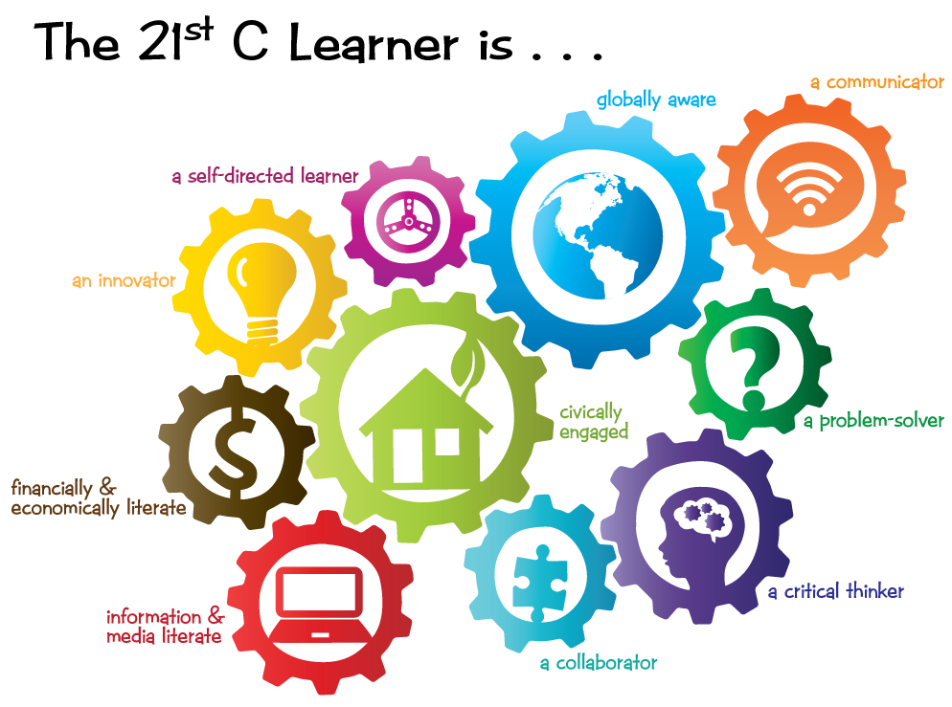
Notes:
Firstly, it is important to understand the type of learners that we currently have

Slide 7
Supporting Student A: case study
Notes:
Student profile
Verbally articulate
3rd year
ISP
Dissertation represented a large document with many elements

Slide 8
What are the qualities of good assessment?
Notes:
To support her It was important to as the following questions:
Does the assessment currently enable us to assess and feedback of students’ A mastery of important skills and behaviours/ attitudes, as well as their knowledge?
Did the current assessment methods enable her to demonstrate her ability to achieve the learning outcomes?
Was the assessment appropriate?
Did we study her specific learning strategies and ability to feed forward her teachers’ feedback?
Are summative assessments positioned to capture student A’s final integrated learning?

Slide 9
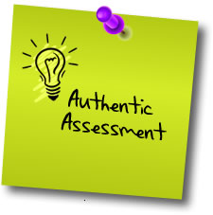
Developing an individualised authentic assessment
Asked student A to present dissertation as a VIVA VOCE
This represented meaningful instructional activity that suited her Specific Learning needs
Allowed spontaneous thinking and problem-solving skills
Real-world applications
Notes:
It was important that we developed an authentic assessment “An assessment requiring students to use the […] competencies,
or combinations of knowledge, skills, and attitudes that they need to apply in the criterion situation in professional life.” (Gulikers, Bastiaens, & Kirschner, 2004, p. 69)
Authentic and sustainable assessment: focuses on assessment tasks that have applicability to the world outside the classroom and that foster autonomous learning
Provide proficiencies and skills required for employability

Slide 10
Examples of innovative assessments
Conferences
Role plays
Group posters
Forum discussions
Podcasts/ videos
Presenting to employers/service users or peers
Video assignments (alternatives to essays)
Notes:
This student Case made us think of the assessments that we use as formative that can be used to support summative assessments

Slide 11
Conclusion
This case study demonstrated that a planned alternative assessment enhanced Student A’s learning experience.
Key is to involve lecturers so there is understanding of students Specific Learning Needs.
There is support, flexibility and accessibility across the curriculum and this ought to be extended to assessment.
Assessment is the engine which drive students learning it is important that.

Slide 13
References
Bloxham, S. and Boyd, P. (2007). Developing Effective Assessment In Higher Education: A Practical Guide: A Practical Guide. UK: McGraw-Hill Education.
Burley, M. (2014). Eric Mazur Assessment - The Silent Killer of Learning. [video online] Available at: <https://www.youtube.com/watch?v=8sh6wsUFQT0> [Accessed 17 June 2023].
Cowan, J. (2005). Designing assessment to enhance student learning. Available at: http://www.enhancementthemes.ac.uk/docs/workshop/designing-assessment-to-enhance-student-learning-paper.pdf
Gibbs, G. (1999). Using Assessment Strategically to Change the Way Students. Assessment matters in higher education, pp. 43-47.
Gulikers, J.T., Bastiaens, T.J. and Kirschner, P.A. (2004). A five-dimensional framework for authentic assessment. Educational technology research and development, 52(3), pp. 67-86.
Nicol, D. (2007). ‘Principles of good assessment and feedback: Theory and practice’, Assessment design for learner responsibility 29-31 May 07.
Pells, R. (2017). Oxford University faces sexism allegations over claim sitting exams at home 'will close gender gap'. [online] The Independent. Available at: https://www.independent.co.uk/news/education/education-news/oxford-university-sexism-row-outcry-exams-home-gender-gap-a7785596.html [Accessed 23 Apr. 2018].
Principles and Methods of Assessment. (2015). Principles and Methods of Assessment. [online] Available at: https://abdao.wordpress.com/ [Accessed 20 Apr. 2018].

