Slide 1
Comics as Assessment
Festival of Teaching and Learning
6 July 2023
Rachel Branham

Slide 2
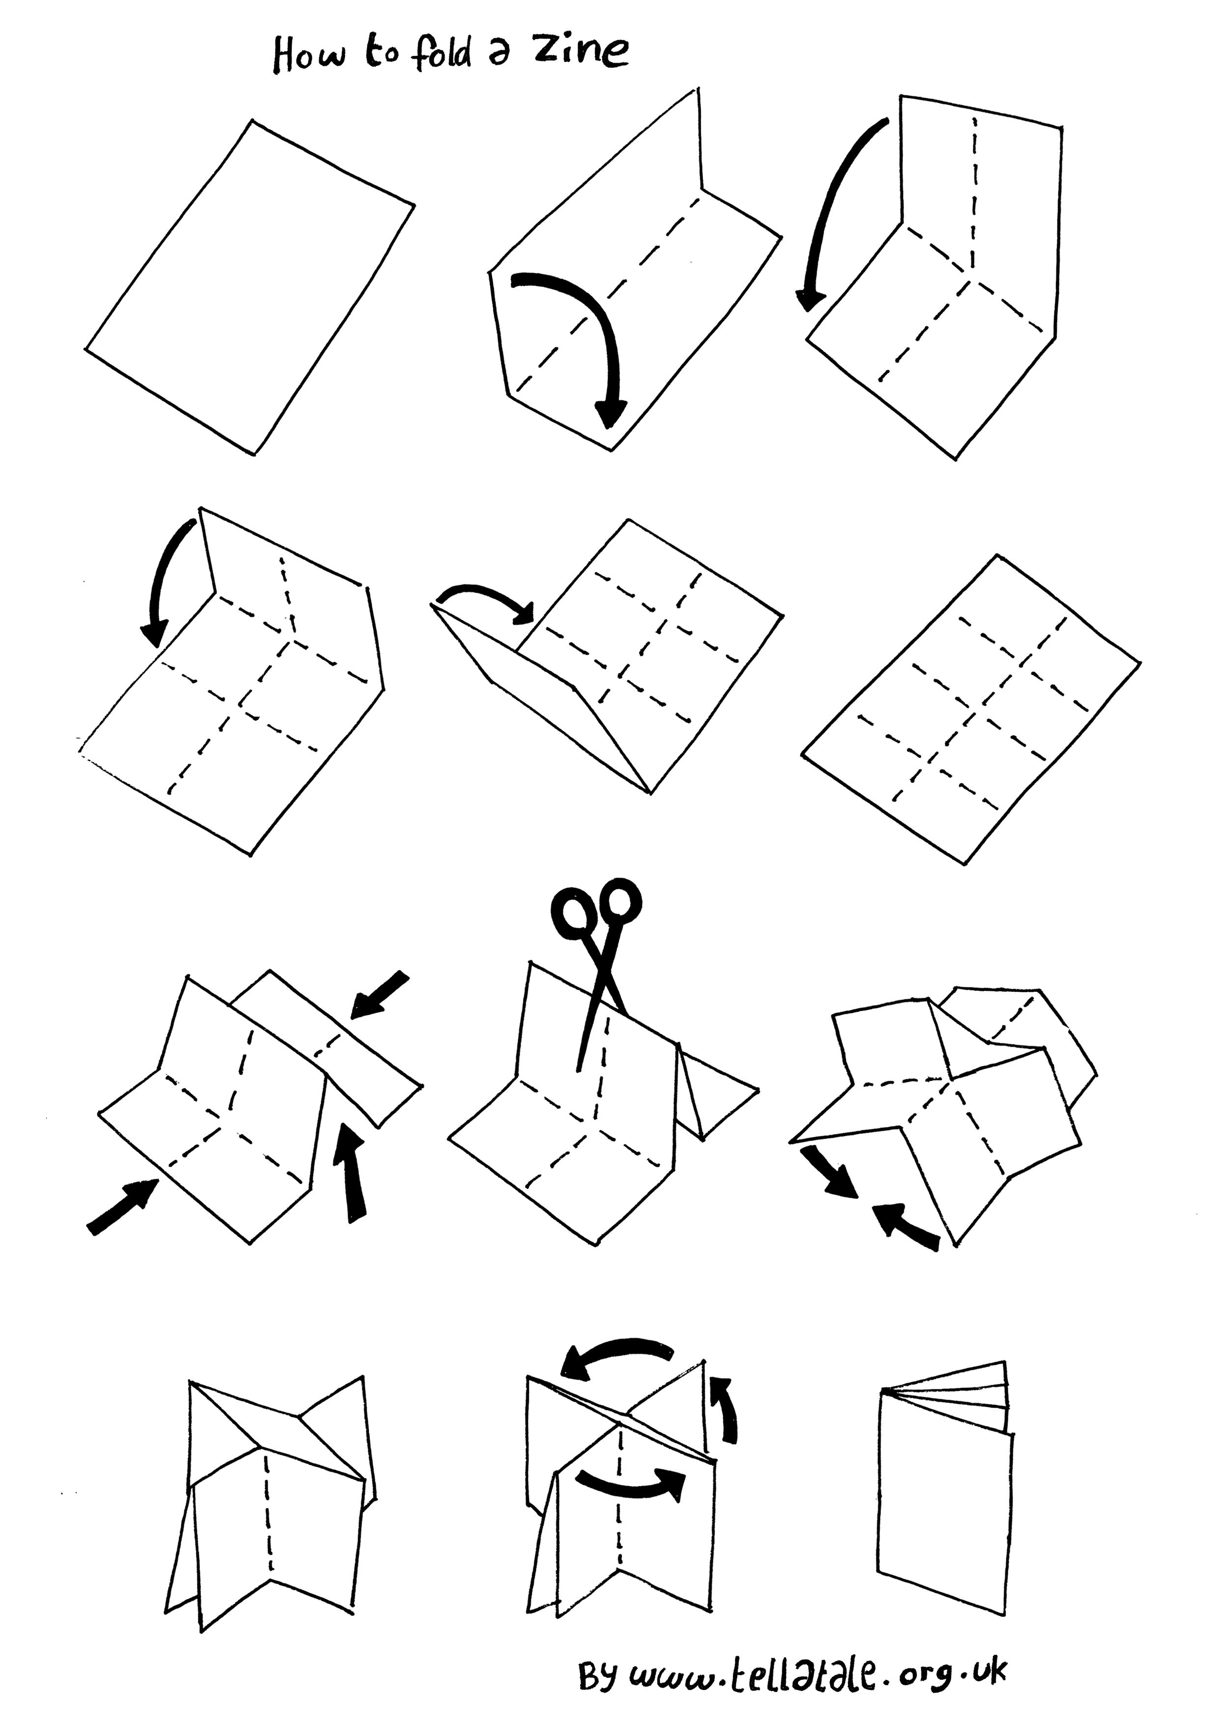
What's this little book?
Zines (short for 'magazines') are inexpensive, easy to make and distribute, and are great tools for note-taking and brainstorming. If it gets unfolded, or if you want to make your own, refer to the diagram to the left.

Slide 3
What are comics?
Comics are a union of text and image, illustrated sequential narrative in time and space... "juxtaposed pictorial and other images in deliberate sequence" (Scott McCloud)
There are many genres in comics, it is its own medium that is accessible yet complex, textured, and diverse application.
Comics are "a possible metaphor for memory and recollection" (Chris Ware)
"The words and images entwine, but never synthesize" (Hilary Chute)
Time as space... comics "choreograph and shape time" (Art Spiegelman
Comics as Assessment, #FLT23 Branham

Slide 4
Charles Shultz, Peanuts
Comics as Assessment, #FLT23 Branham

Slide 5
PARTS OF A COMIC​
Panel
Speech bubble
Gutter
Time
Space
Comics as Assessment, #FLT23 Branham

Slide 6
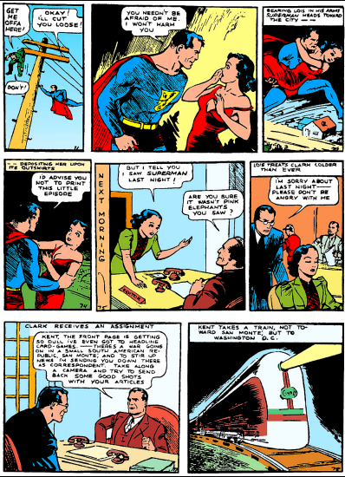
Jerry Siegel and Joe Shuster, Action Comics #1

Slide 7
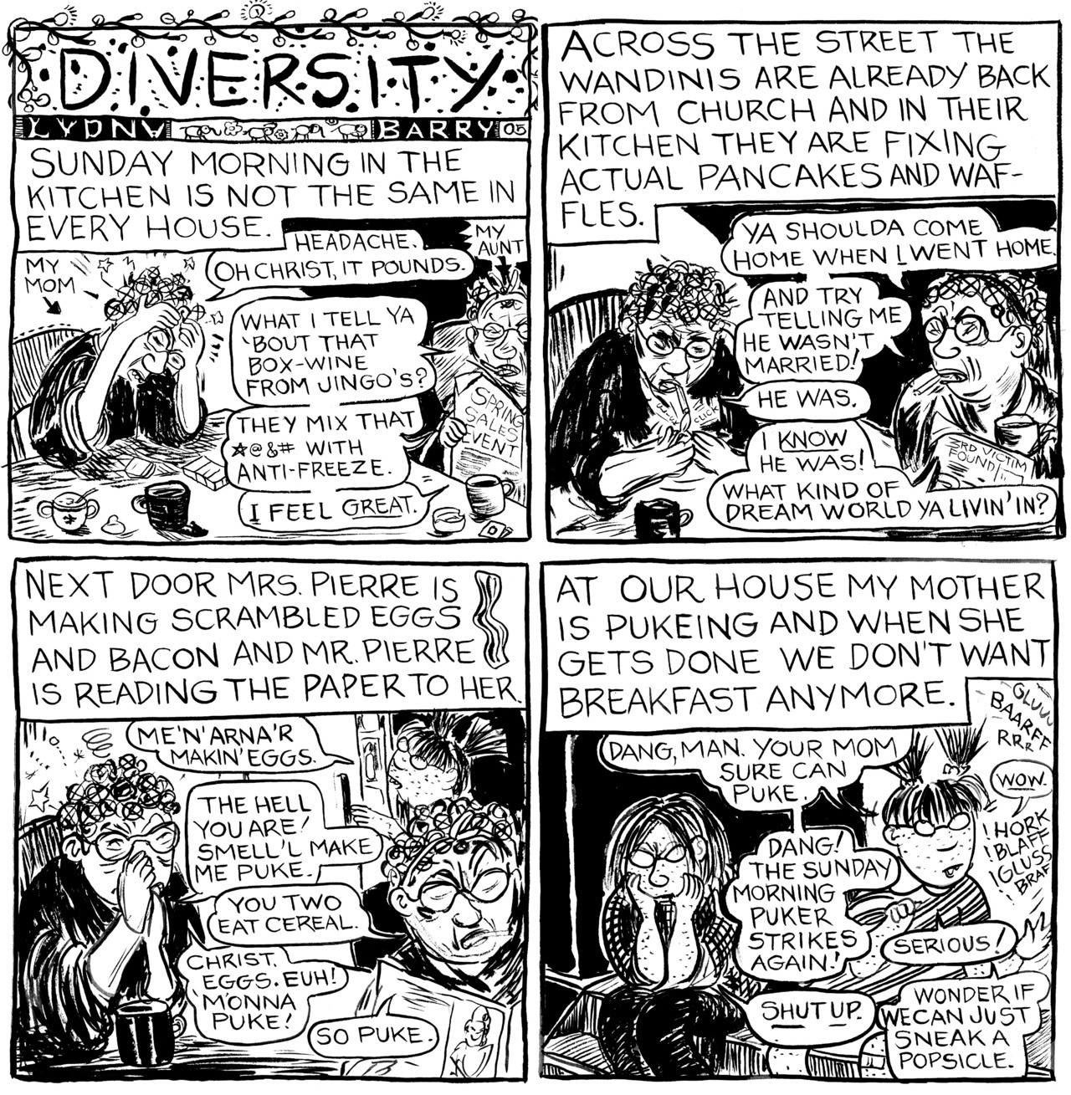
Lynda Barry, Diversity

Slide 8
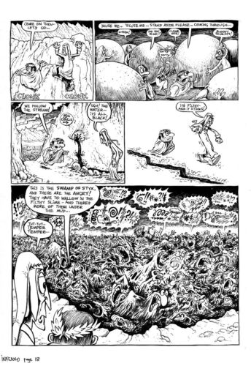
Hunt Emerson, Dante's Inferno

Slide 9
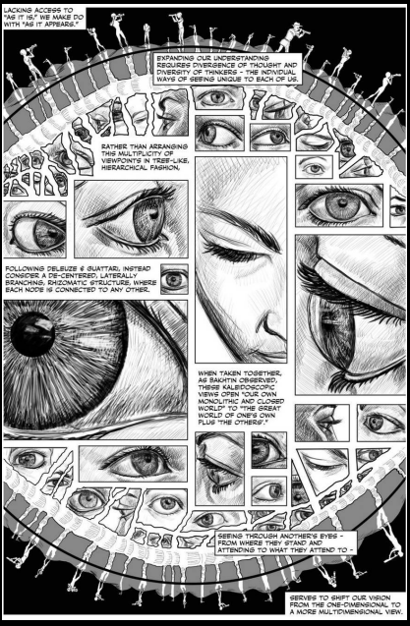
Nick Sousanis, Unflattening

Slide 10
Why Comics?
Visualizations make abstract concepts more concrete
Words and graphics support active learning (verbal accompaniment is even better)
Sequential design illustrates processes, cause and effect, etc.
Space-oriented and time-oriented
Further supports reading and writing
Emphasis on application of knowledge
Formative assessment to summative- checkpoints to ensure authenticity
Wider engagement and participation, individual and group
Technologies to support: Pixton, Canva, Adobe Express, and more
Continued reflection through recreation, amplified through kinesthetic motion
Variety of student products = more enjoyable marking!
Comics as Assessment, #FLT23, Branham

Slide 11
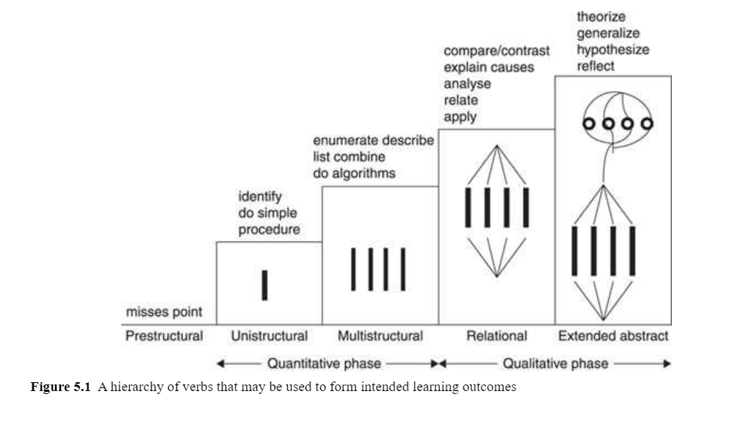
When you create a comic about something, you are teaching that something to someone else. This is higher order thinking, critical and creative thinking, relational and extended abstract thinking.
Biggs, SOLO Taxonomy
Comics as Assessment, #FLT23, Branham

Slide 12
Assessment Criteria
Employability: Collaboration and team working skills; creative problem solving; time management consideration; overcoming obstacles, stepping outside of one's comfort zone; revision processes; setting goals and following through with projects
AI-proof: Personal reflections and experiences; check points for formative assessment leading to summative assessment; deliberate rephrasing and application of knowledge through multiple formats to different audiences
Sustainability: Technology options; inclusion of verbal/audio explanation; accessible design; future-proof; narratives from lived experiences and perspectives
Comics as Assessment, #FLT23, Branham

Slide 13
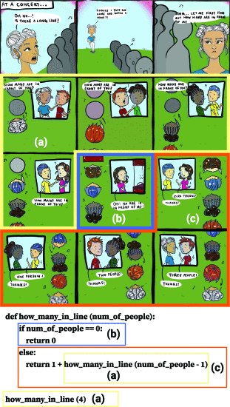
Case Study: University of Waterloo
Computing education: coding and programming
3-hour workshop: series of exercises followed by dedicated work time; feedforward
Ideation/design process (trigger, scenario, story+code, design, draw)
Use of completed comics for further teaching and learning
Positive reception, continued application of practice
From Suh, et al.: "Coding strip example on recursion using the lens [7] design pattern to illustrate the execution steps in the recursion code: (a) function call (forward recursion), (b) base case, and (c) return (backward recursion)"

Slide 14
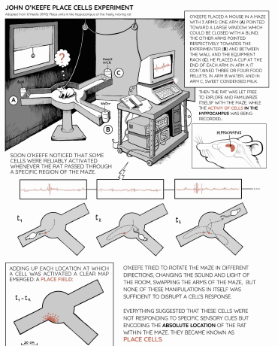
Case Study: University of Edinburgh
Data visualization and pattern recognition, "novel but scarcely explored"
3-hour workshop: series of exercises followed by dedicated work time; feedforward
Variation and expansion (infographics-space only; comics- space and time)
Data-driven story-telling; public engagement; genre-blending
From Bach, et al.: O’Keefe’s experiment (©Matteo Farinella) includes scale consideration, time sequences, and juxtaposition of perspectives (researcher and subject)

Slide 15
Pedagogic truths from an art teacher
All human beings are creative
All human beings are built for making art
All human beings are programmed to tell stories
All human beings are driven to connect
All human beings can draw
Making art is intimidating. How do we show up for our students to say it's ok to be vulnerable? To make mistakes? To try new things and start over if they don't work out?
The arts are not extra; they are extensions of our humanity.
Comics as Assessment, #FLT23, Branham

Slide 16
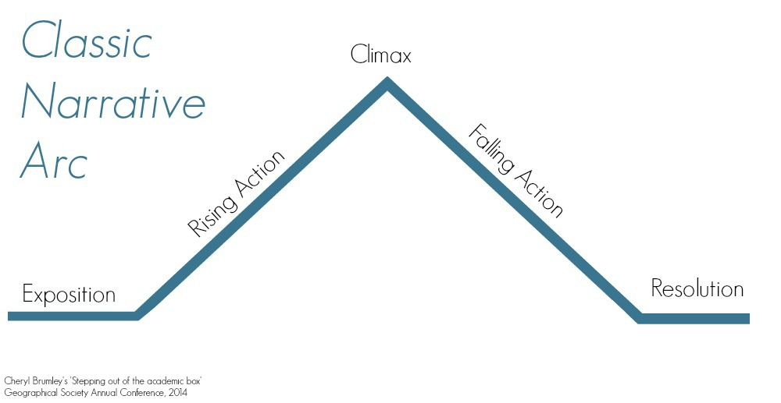
Design process and considerations
Concepts
Story
Comics design
Pose questions for deeper investigation and elaboration
Examples: what is the principle used for? What is a strength/weakness? How does it compare to a similar concept?
Setting, characters, conflict, action; Narrative Arc
Sequence design, implicit v. explicit, repetition, visual patterns, etc.
Simple drafts with opportunity for peer review, feedforward and revision
Cheryl Brumley, 2014
Comics as Assessment, #FLT23, Branham

Slide 17
Experimentation
Brainstorm concepts addressed in assessments in your module and select one to experiment with
Comics as Assessment, #FLT23, Branham

Slide 18
Experimentation
Brainstorm concepts addressed in assessments in your module and select one to experiment with
Respond to the prompts in your zine
Comics as Assessment, #FLT23, Branham

Slide 19
Experimentation
Brainstorm concepts addressed in assessments in your module and select one to experiment with
Respond to the prompts in your zine
Fill in the Narrative Arc in your zine
Comics as Assessment, #FLT23, Branham

Slide 20
Experimentation
Brainstorm concepts addressed in assessments in your module and select one to experiment with
Respond to the prompts in your zine
Fill in the Narrative Arc in your zine
Create a draft (or two) using stick figures
Comics as Assessment, #FLT23, Branham

Slide 21
Experimentation
Brainstorm concepts addressed in assessments in your module and select one to experiment with
Respond to the prompts in your zine
Fill in the Narrative Arc in your zine
Create a draft (or two) using stick figures
Share with a neighbor
Comics as Assessment, #FLT23, Branham

Slide 22
Final reflections
pollev.com/rachelb654
How did this experience land with you?
What further questions do you have?
What will you take from this experience?
Comics as Assessment, #FLT23, Branham

Slide 23
"In every other narrative that I know of, past, present, and future are not shown simultaneously- you're always in the now... you're looking at panels, which if you're looking at panel two on page two, then to its left is the past, and to its right is the future. And your perception of the present moves across it"
(McCloud in Chute, 2007)
Comics as Assessment, #FLT23, Branham

Slide 24
Resources
Barry, L. (2019) Making comics. Montreal, QC: Drawn and Quarterly.
Barry, L. (2014) Syllabus: Notes from an accidental professor. Montreal, QC: Drawn and Quarterly.
Barry, L. (2008) What it is: the nameless thing which gives things form. Montreal, QC: Drawn and Quarterly.
Brunetti, I. (2011) Cartooning: Philosophy and practice. New Haven, CT: Yale University Press.
Eisner, W. (2008) Graphic storytelling and sequential narrative. 3rd edition. New York, NY: W. W. Norton.
Kirtley, S., Garcia, A., and Carlson, P. (eds.) (2020) With great power comes great pedagogy. Jackson, MS: University Press of Mississippi.
McCloud, S. (1993) Understanding comics: The invisible art. New York, NY: William Morrow Paperbacks.
The Comics Grid: Journal of comics scholarship. Available at https://www.comicsgrid.com/
Comics as Assessment, #FLT23, Branham

Slide 25
References
Bach, B., et al. (2018) 'Design Patterns for Data Comics', CHI Conference on Human Factors in Computing Systems, Montreal, QC, April 21–26, 2018, Paper No. 38, pp. 1–12. Available at https://doi.org/10.1145/3173574.3173612 (Accessed 5/6/23).
Biggs, J. B. and Tang, C. (2011) Teaching for quality learning at university. 4th edn. Maidenhead, UK: McGraw-Hill/Society for Research into Higher Education/Open University Press.
Chute, H. (2010) Graphic Women. New York: Columbia. Press.
Chute, H. (2007) "Scott McCloud", Believer, March 2007, pp. 80-86. Available at: https://www.thebeliever.net/an-interview-with-scott-mccloud/ (Accessed 5/12/22).
Clark, R. C. and Mayer, R. (2016) e-learning and the science of instruction. Available at https://ereader.perlego.com/1/book/991272 (Accessed 25/5/23).
Lee, J. (2023) 'Effective assessment practices for a ChatGPT-enabled world', Times Higher Education.
Available at https://www.timeshighereducation.com/campus/effective-assessment-practices-chatgptenabled-world?utm_source=mkg&utm_medium=email&utm_campaign=showcase&spMailingID=25951449&spUserID=MTIwMzk1NzEyNjk1OQS2&spJobID=2234723910&spReportId=MjIzNDcyMzkxMAS2 (Accessed 5/6/23).
McCloud, S. (1993) Understanding comics: The invisible art. New York, NY: William Morrow Paperbacks.
Mishra, P., Kumar, S. and Chaube, M.K. (2023) 'Graph Interpretation, Summarization and Visualization Techniques: A Review and Open Research Issues', Multimed Tools Appl 82, pp. 8729–8771. Available at https://doi.org/10.1007/s11042-021-11582-9 (Accessed (1/6/23).
Suh, S., et al. (2020) 'Coding Strip: A Pedagogical Tool for Teaching and Learning Programming Concepts through Comics', 2020 IEEE Symposium on Visual Languages and Human-Centric Computing (VL/HCC), Dunedin, New Zealand, 10-14 August 2020, pp. 1-10. Available at http://doi.org10.1109/VL/HCC50065.2020.9127262 (Accessed 25/5/23).
Ware, C. (ed). (2007) Best American Comics 2007 pp. xiii-xxiv. Boston, MA: Houghton Mifflin.
Comics as Assessment, #FLT23, Branham

