Slide 1
Innovative authentic assessments for a global dementia workforce
Laura Cole, Eleanor Lee and Kajal Chaundhary

Slide 2
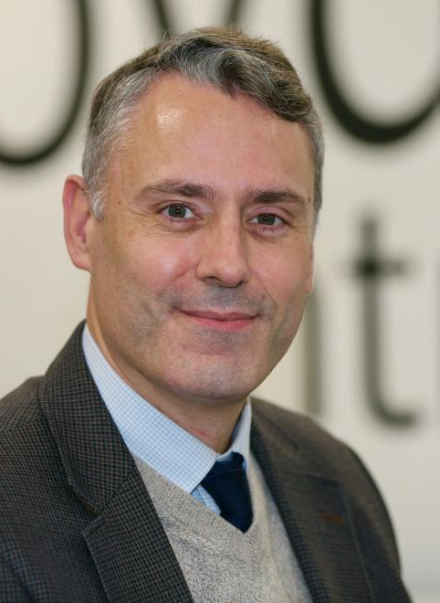
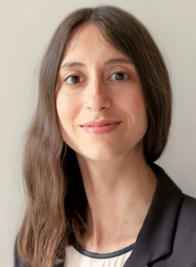
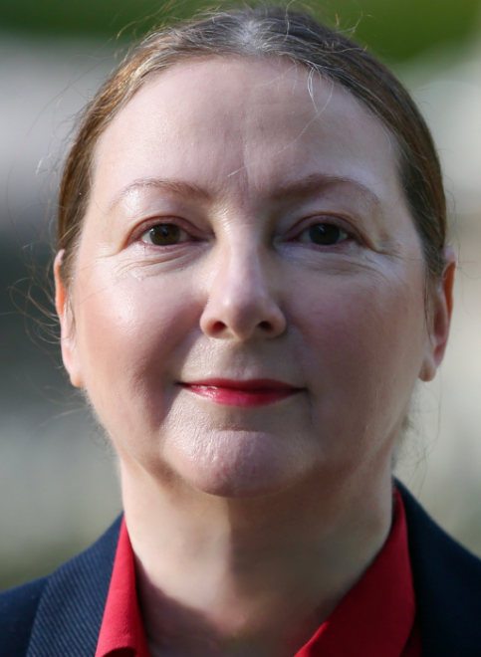
Acknowledgements: Course Team
Prof Juanita Hoe,
Director of PG Education
Dr Snorri B Rafnsson, Module Lead
Dr Federica D’Andrea, Module Lead
Prof Katie Featherstone,
Director of GIAM

Slide 3
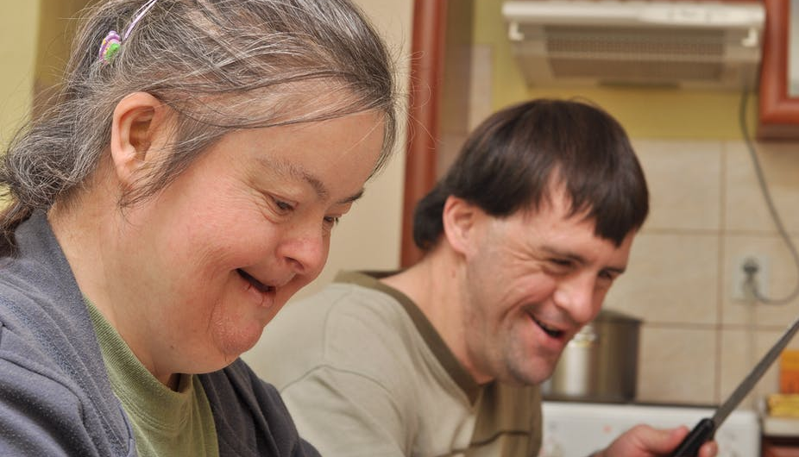
Background
Dementia is a concern for health and social care services globally
Requires a workforce with specialist knowledge and leadership skills
MSc Dementia Studies:
Contemporary Approaches to Practice
Innovative
Flexible
Reflect the needs of students and employers

Slide 4
Authentic assessments
Real-world tasks which are career focused (Leedham, 2009).
Writing a blog
Designing an infographic
Presenting a ‘dragon’s den’ type pitch
Multidisciplinary
Innovation = creativity

Slide 5
Supporting students
Demonstrate a range of academic skills
Accommodate for diverse learning needs
Knowledge exchange activities with a variety of audiences /stakeholders
Formative assessments
Drop-in sessions
(Huertas et al., 2019)

Slide 6
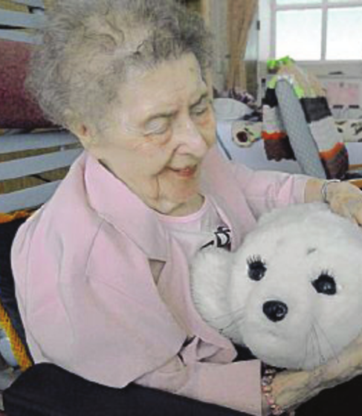
Student experiences
Exposure to different types of communication medians, e.g., social media
Variety of assessments
Capitalise on individual strengths and helps confidence
Adjust back to academia
Learn to self-learn (level 7)

Slide 7
Reflections from teaching team
Strengthen depth of knowledge and provide a convincing argument
Formative assessments and drop-in sessions
Embedding assessment literacy
Review and refine

Slide 8
Take away messages
Real world tasks
Variety of assessments
Inclusivity
Encourage innovation
Keeping it fresh
Huertas Barros, E. & Vine, J. (2019). Training the Trainers in Embedding Assessment Literacy into Module Design: A Case Study of a Collaborative Transcreation Project. Interpreter and Translator Trainer, 13(3), 271-291.
Leedham, M. (2009). From traditional essay to “Ready Steady Cook” presentation: reasons for innovative changes in assignments. Active Learning in Higher Education, 10(3), 191-206.
Contact: Dr Laura Cole (Course Lead) laura.cole@uwl.ac.uk

