Slide 1
Reflections on Test-Driven Marking for Programming Assessments
Dr Malte Ressin Senior Lecturer, School of Computing and Engineering
Notes:
Code submitted for programming assessments can exhibit complex behaviour too difficult to predict by inspection alone. Since computer code is meant to be interpreted and executed by machines, it stands to reason to evaluate submissions by actually running the code. However, as manual process, this is a work-intensive and error-prone.
To alleviate this, it was attempted to automate running and testing of code submissions by comparing actual code output to expected results for sets of pre-formulated input parameters, a concept known as unit testing in software development.
This presentation looks back at three years of effort automating part of the marking process. While experience shows student acceptance and an increase in submission quality. However, a certain amount of additional support is required. Further, automated code testing requires significantly more assessment preparation and is a complex programming problem in its own right. Following reflection, future efforts using existing web-based solutions will be discussed.

Slide 2
Functional Programming
Learning Outcomes:
Apply the functional model, in which programs are a set of nested expressions.
Design recursive functions using base and recursive cases.
Write, understand and analyse functional programs in Haskell
Assessment task example:
Define a recursive function that merges two sorted lists to give a single sorted list. For example: merge [2,5,6] [1,3,4] should output [1,2,3,4,5,6] Note: your definition should not use other functions on sorted lists such as insert or isort, but should be defined using explicit recursion

Slide 3
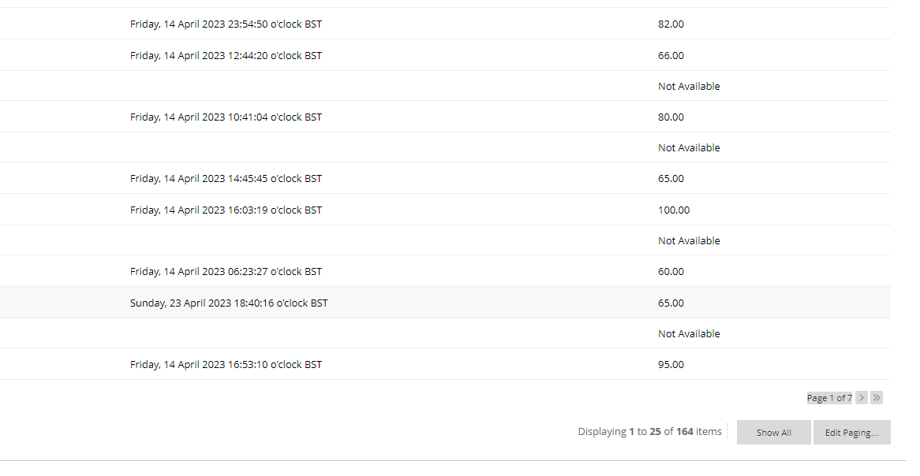
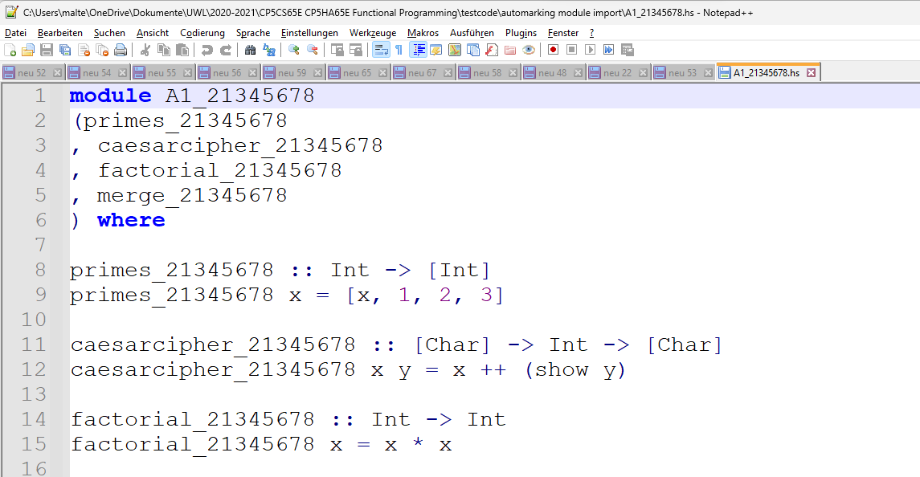
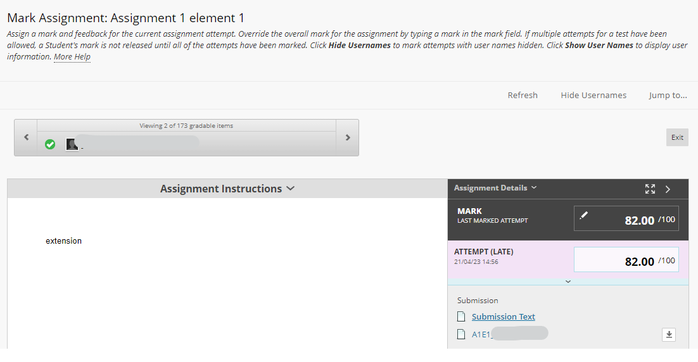
Marking process
Download submission(s)
Load or copy&paste into IDE
Run code
How does the code handle edge cases?
Inspect code if applicable
(Assign grade)
Can this be automated?

Slide 4
Inspiration
Unit tests in Software Engineering:
How to ensure that code changes (e.g., a bugfix) does not introduce new errors?
Solution: Central code repository, persistent checks on changes:
Does the code compile?
Does it successfully complete a defined test suite incl. test edge cases, etc.?
=> Test-Driven Development

Slide 5
Test-Driven Marking
Automating manual steps
Does the code run?
Handling of (edge) cases, e.g.:
merge [2,5,6] [1,3,4] = [1,2,3,4,5,6]
merge [1,2,3,4] [5,6] = [1,2,3,4,5,6]
merge [1,2,3] [] = [1,2,3]
merge [] [] = []
…

Slide 6
Test-Driven Marking
Strictly defined interface for students including function and file names
Define a recursive function merge_<your_student_number> :: Ord a => [a] -> [a] -> [a] that merges two sorted lists to give a single sorted list. For example:
merge_<your_student_number> [2,5,6] [1,3,4] would return [1,2,3,4,5,6]
Submit all four functions in one Haskell module. The module must be called A1_<your_student_number> and must export all four functions mentioned above. The main Haskell start file must be called A1_<your_student_number>.hs. The zip file must be called A1_<your_student_number>.zip.
So, for example, if your student number were 21345678, then the zip file must be called A1_21345678.zip. Upon unzipping it into a folder of choice, said folder will contain the module file A1_21345678.hs, which will export the function merge_21345678 as described above.

Slide 7
Results in 2021
150 students, 100 submissions, 91 submissions were compressed
6 compressed in wrong format (rar, 7zip)
24 did not name the files correctly
Mixed up characters, e.g., „l“ instead of „1“: 3
Appended to filename, e.g., „(1)“, „(2)“, „_“, „“: 8
Cut filename, e.g., missed „“ or „_“: 1
Extension „.zip.zip“: 8
Did not keep to file name at all: 5
10 submitted uncompressed source code (with 4 incorrect filenames)
7 used the code submission links to submit the report, 2 of which were in an unrecognised format
2 submitted the code using the report submission link

Slide 8
Results in 2021
Resit: 32 submissions
26 compressed (all in correct format)
Missing or added character from filename: xxxx
Capitalisation error: xx
Filename entirely incorrect: xxxxxxx
(1) (2) etc added: x
.zip.zip: x
5 source code
Of which 3 in incorrect file format
1 report

Slide 9
Changes for 2022
No more file compression
No more report, instead comment in code
Define a recursive function merge :: Ord a => [a] -> [a] -> [a] that merges two sorted lists to give a single sorted list. For example: merge [2,5,6] [1,3,4] would return [1,2,3,4,5,6] Note: Your definition should not use other functions on sorted lists such as insert or isort, but should be defined using explicit recursion.
Using the respective link for the code submission, submit your Haskell code as a Haskell code (.hs) file as follows: Submit all three functions in one Haskell module. The module must be called A1E2_<your_student_number> and must export all six functions mentioned above. The Haskell start file must be called A1E2_<your_student_number>.hs.
So, for example, if your student number were 21345678, then the Haskell file must be named A1E2_21345678.hs, the module must be called A1E2_21345678, and it must export the functions merge, encrypt, decrypt, and the definition of the Functor instance for the binary tree, as described above.

Slide 10
Results in 2022
2022 first sit: 132 students, 100 submissions
8 compressed, of which
3 in incorrect filename
2 reports
96 source code
Mixed up characters, e.g., „l“ instead of „1“: 2
Extension „.hs.hs“: 3
Incomplete filename: 3
Incorrect filename: 3
Incorrect programming language: 1

Slide 11
Results in 2022
2022 resit: 14 submissions
1 compressed
2 reports
10 code files, of which
Completely wrong filename: xxx
.hs.hs: x
Appended: xx
Incorrect filename: x
.txt: xx

Slide 12
Results in 2023
164 students, 127 submissions:
Code files:
Incorrect extension: xx
.hs.hs: xx
[1] etc.: xxx
_, „ „: xxx
Typo: x
2 compressed:
3 reports

Slide 13
What went well
Overall testing

Slide 14
Ethical considerations
Can I modify student solutions to make them run?

Slide 15
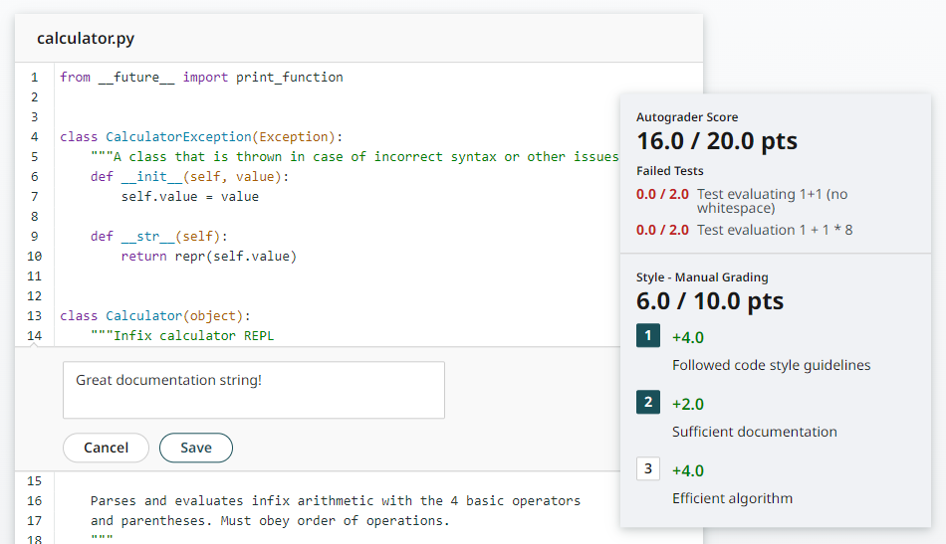
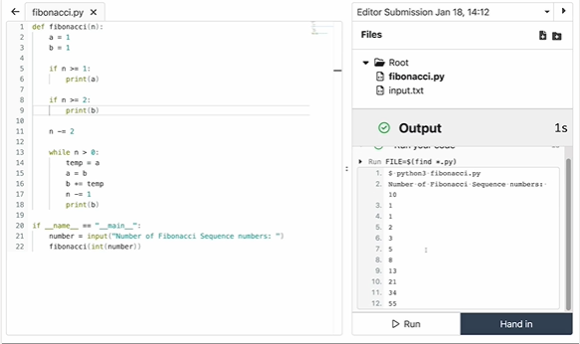
Outcome
Automatic testing of programming assessments is an interesting engineering problem.
Implementation effort is user interaction
An integrated solution, e.g., web interface, should work much better.

