Slide 1
Utilising group dynamics to provide learning opportunities for social work students.
Maureen Mguni & Dr Arlene P Weekes
Notes:
Maureen
What is Group Work
Hundreds of fish swimming together are called a school. A pack of foraging baboons is a troupe. A half dozen crows on a telephone line is a murder. A gam is a group of whales. But what is a collection of human beings called? A group. …. [C]ollections of people may seem unique, but each possesses that one critical element that defines a group: connections linking the individual members…. [M]embers are linked together in a web of interpersonal relationships. Thus, a group is defined as two or more individuals who are connected to one another by social relationships. Donelson R. Forsyth (2006: 2-3)
‘two or more individuals who are connected to one another by and within social relationships’. Donelson R. Forsyth (2017: 3)

Slide 2
Groupwork in action
No. of students | Type of group | Activity | Lecture/Module
2 | Dyads/pairs | Think, Pair & Share | Contemporary Social Work
3 | Triads/trios | Reflective Triads | Adult Social Work Understanding Diversity & Human Rights
4 | Tetrads/quartets | Problem Based Learning | Practice Education Professional Standards (CPD) Social Work Law
5 | Quintet or Sextet/heads | Jigsaw | Understanding Diversity & Human Rights
43 | Whole class | Debate | Ethics and Human Rights
Notes:
ARLENE

Slide 3
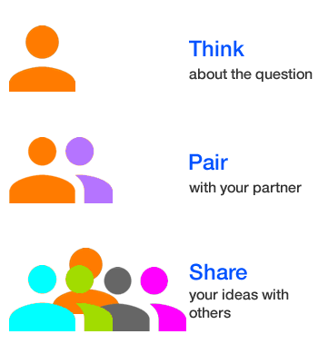
Activity
Think pair share research.
Think-pair-share (TPS) is a collaborative learning strategy where students work together to solve a problem or answer a question about an assigned reading.
Think-Pair-Share-template.pdf (readingrockets.org)
https://www.pinterest.co.uk/pin/talking--452189618829239607/
Notes:
ARLENE How to Use https://www.theteachertoolkit.com/index.php/tool/think-pair-share
1. Think Have students write a response to a prompt or a question. PreK-K students can draw their thinking.
2. Pair Tell students to pair up and share their responses.
3. Share Reconvene the class and ask pairs to report back on their conversations.
When to Use
Use Think-Pair-Share at any point in the lesson to structure meaningful conversation:
Before introducing new material to tap into prior knowledge
After watching a film clip to gauge a reaction
After reading a short text to begin a discussion
Before students begin an assignment, such as an essay or a set of word problems, to gather ideas or formalize procedures
Variations
Think-Listening Pair-Share To work on students’ listening skills, tell them that they can only share their partner’s viewpoint during “Share.”
Think-Pair-Square After “Pair,” have partners “Square” with another pair to discuss their ideas, making a group of 4.
Seminar activity
Working in pairs on the allocated mental illness:
- Devise a conceptual map for how you would work with a service-user who was struggling with their housing tenancy.
Anxiety
Depression
Eating problems
Schizophrenia
Phobias
Obsessive Compulsive Disorder
Bipolar disorder
Personality disorders
PTSD
Disruptive behaviour and dissocial disorders

Slide 4
Triads
Reporter
Enabler
Presenter
Adapted from Brockbank and McGill 2007
Notes:
MAUREEN
Presenter:
Consider a critical incident relating to your own learning and teaching
Enabler:
You should work with the Presenter to try to help them explore the individual read about more. You need to help them to focus more as well as to begin exploring possible ways forward. Try to be non-judgemental and to ask open questions. Try to focus on what can be done by the presenter, not what he or she ought to do, or what you would do.
Reporter:
You should observe the interaction, and aim to give a concise summary of the discussion. You can also give some suggestions about how some of the issues raised might possibly link to social work practice. What areas of further research could the Presenter do to gather some ideas about how to move forward?
Or students all read article and share what they have read with colleagues.
ACTIVITY In triads each person reads journal article and shares learning about article with other group members.

Slide 5
Notes:
MAUREEN Allowing students (student centred and lead) to learn through solving real problems.
Solving a problem and acquiring knowledge.

Slide 6
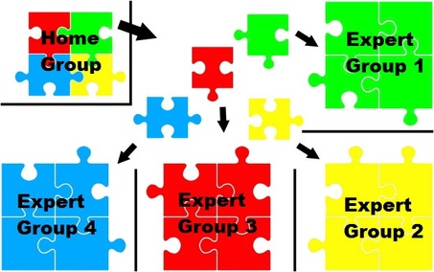
J
i
g
s
aw
https://strategiesforspecialinterventions.weebly.com/jigsaw1.html
https://www.readingrockets.org/strategies/jigsaw
http://www.cultofpedagogy.com/
Notes:
ARLENE
Divide students into groups -6
Diveid content into chunks of 4-6
Assigign one chunk of content to each person in jigsaw group
Hace students meet in expert groups
Students return to jigsaw groups
ACTICTY – social class
I theories
Types
Defining & measuring
Problems of social class
Differences in countries

Slide 7
Class Debate
In pairs
Identify the main point for and against.
In groups of fours
Produce the two strongest arguments you have.
Consider the arguments that the other side are going to produce and prepare to argue against them.
The two groups to debate the for and against
Notes:
ARLENE

Slide 8
Take-away for academics
Impact on students
Anti-Discriminatory Practice
Regulatory body standards
Communication
Multi-agency working
Higher level learning
I called Arlene for some guidance because I had put together a peer learning discussion and wanted those that were joining to engage with the topic in a more active way than just having a conversation. Arlene always has my peers and I doing different activities while in lectures so I thought she would be the best person to ask for help. After explaining my topic and how I wanted to structure the session, Arlene suggested Think-Pair-Share. Although my group was small, it was a great activity and suited the session’s topic well. The activity helped the group become more engaged and promoted participation amongst the entire group. Without the help of Arlene, the session may have not gone so well (Level 6 student feedback).
Thank you for incorporating groupwork into our learning Maureen. I enjoyed doing the research with my group and having to present back to all the other students. It was good to hear from my colleagues too- we are all facing similar challenges. I am not normally keen on presenting but I found this way of learning very enjoyable and effective (PEPs student).

