Slide 1
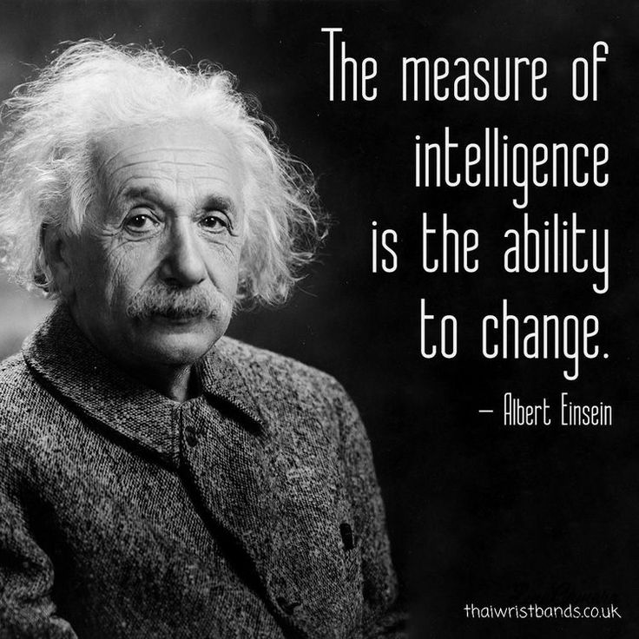
Measuring Knowledge and Learner Success and Higher-Order Thinking Skills in the Age of AI

Slide 2
Aims of this discussion workshop
AI (the elephant in the room) and what we’re doing about it?
Do we all share the same fears and hopes for AI regarding teaching, learning and assessment in higher education?
Output: Food for thought, a sense of direction, unity and ideas for change and further discussion

Slide 3
Group Discussion Agenda (x5 discussions)
1. Importance of assessing learner success in higher education
2. The impact of artificial intelligence on measuring knowledge & learner success
3. How do you assess higher-order thinking skills?
4. Ideas for authentic assessments
5. Ideas for metacognitive assessments
Wrap Up
3 minutes
4 minutes
4 minutes
4 minutes
4 minutes
3 minutes

Slide 4
1. Importance of assessing learner success in higher education
In your groups, how would you define the importance of measuring and assessing learner success in higher education?
What is society/ industry looking for from UWL graduates?
What are future students looking for in higher education?
Discuss and share within your groups/ room

Slide 5
Different Types of Knowledge
Explicit
Implicit
Tacit
Explicit Knowledge: Knowledge that is easy to articulate, write down, and share.
Implicit Knowledge: The application of explicit knowledge. Skills transferable from one job to another are one example of implicit knowledge.
Tacit Knowledge: Knowledge gained from personal experience that is more difficult to express.
Nonaka-Takeuchi model (1995)

Slide 6
2. The impact of artificial intelligence on measuring knowledge & learner success
Using the new version of Bloom’s Taxonomy in your groups, discuss how you assess your students learning today.
Which ones do you feel AI will make assessing more challenging and why?
Discuss and share within your groups/ room

Slide 7
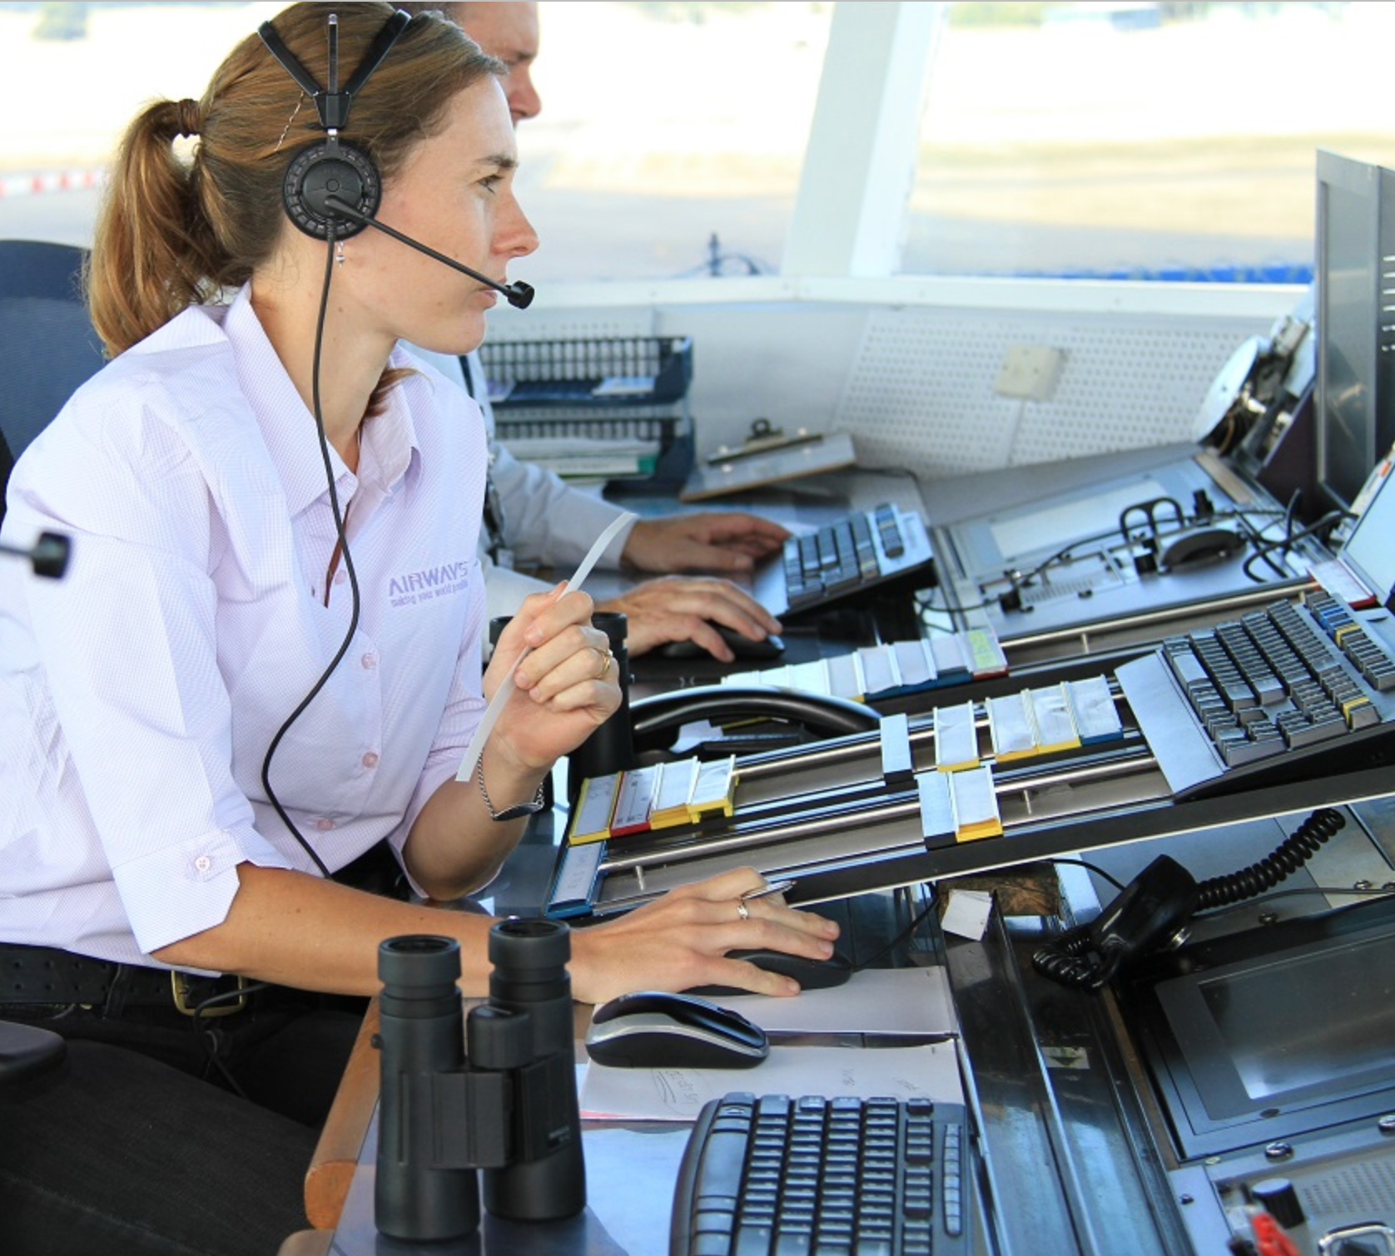
Explanation of Higher Order Thinking Skills
Executive function refers to a set of cognitive processes responsible for skills such as planning, organising, problem-solving, decision-making, self-control, and working memory.
Metacognition, on the other hand, refers to the ability to think about and monitor one's own cognitive processes.
Executive Function
Air Traffic Controller
Metacognition
The thinker
Baddeley and Hitch (1974)
Flavell (1979)

Slide 8
3. How do you assess higher-order thinking skills?
Problem-Solving
Creativity and Innovation
Metacognition
Reasoning
Decision Making
Using this list of higher-order thinking skills, are there any things you might change or add to your student assessments for tomorrow?
Discuss and share within your groups/ room
Notes:
Problem Solving: This involves using existing knowledge and skills to find a solution to a new or unfamiliar situation or challenge. For example, a math student might use problem-solving skills to figure out how to apply a mathematical formula to a complex, real-world situation.
Creativity and Innovation: This involves thinking outside the box to come up with new ideas or novel approaches to problems. For example, an art student might demonstrate creativity by creating a sculpture that uses unconventional materials or techniques.
Metacognition: Metacognition involves thinking about one's own thinking, such as self-reflection and self-awareness. It might involve understanding how you learn best, what your strengths and weaknesses are, and how you can improve. A student could demonstrate metacognition by assessing their own understanding after a lesson and determining what they need to study further.
Reasoning: Reasoning involves the ability to provide a basis or justification for something. This could include mathematical reasoning, moral reasoning, or scientific reasoning. For example, a philosophy student could use moral reasoning to form an argument about an ethical issue.
Decision Making: This involves making a choice between different options based on evaluation and critical thinking. For example, a business student might demonstrate decision-making skills by choosing between different marketing strategies based on their potential effectiveness.

Slide 9
Switching Gears Authentic & Metacognitive Assessments

Slide 10
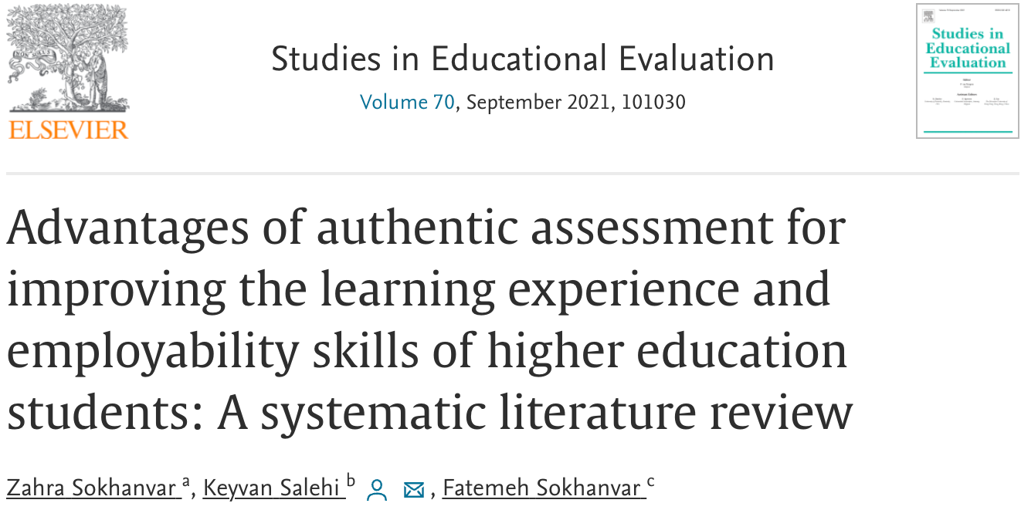
Authentic Assessments
Authentic assessments in higher education are assessment methods that aim to evaluate students' knowledge, skills, and abilities in a context that closely resembles real-world or professional situations. These assessments go beyond traditional tests and exams by emphasising applying knowledge and skills to meaningful tasks or problems.

Slide 11
4. Ideas for authentic assessments
Case studies
Simulations
Projects
Field experiences
Portfolios
Debates or role-playing
Performance assessments
Authentic assessments with technology
Professional collaborations
Self-assessment and reflection
Using this list of ideas for authentic assessment, which ones work best for you and which ones haven’t you tried? Are there others?
Discuss and share within your groups/ room
Notes:
Case studies: Present students with real or realistic scenarios related to their field of research and ask them to analyse the situation, identify problems or challenges, and propose solutions or recommendations. This can be done individually or in groups.
Simulations: Develop interactive simulations that allow students to engage in virtual or simulated real-world experiences. For example, in a nursing program, students could participate in a virtual patient care simulation, making decisions and performing tasks as they would in a natural clinical setting.
Projects: Assign complex, long-term tasks that require students to apply their knowledge and skills to solve real problems or create tangible outcomes. Projects could involve researching, designing prototypes, developing business plans, or creating multimedia presentations.
Field experiences: Provide opportunities for students to engage in real-world experiences outside the classroom. This could involve internships, fieldwork, service-learning projects, or collaborations with industry partners. Students can then reflect on their experiences and connect them to course content through assignments or presentations.
Portfolios: Have students compile a portfolio of their work throughout a course or program. This can include samples of their projects, papers, presentations, and reflections. Portfolios provide a holistic view of students' learning and growth over time.
Debates or role-playing: Organize debates or role-playing activities that simulate professional or disciplinary debates and discussions. Students can research and present arguments from different perspectives, engaging in critical thinking, analysis, and communication.
Performance assessments: Create assessments that require students to demonstrate their skills through performances, such as presentations, demonstrations, or performances in the arts. These assessments can focus on specific competencies or techniques relevant to their discipline.
Authentic assessments with technology: Leverage tools and platforms to design accurate evaluations. For example, students can create websites, develop multimedia projects, or participate in online simulations or virtual reality experiences.
Professional collaborations: Establish collaborations with professionals in the field or industry partners to provide students with real-world challenges or opportunities to work on authentic projects. This can include mentorships, guest lectures, or joint projects.
Self-assessment and reflection: Incorporate opportunities for students to reflect on their learning and performance. This can be done through journals, reflective essays, or structured reflection activities to help students develop metacognitive skills and take ownership of their education.

Slide 12
4. Ideas for authentic assessment
Case studies: Present students with real or realistic scenarios related to their field of research and ask them to analyse the situation, identify problems or challenges, and propose solutions or recommendations. This can be done individually or in groups.
Simulations: Develop interactive simulations that allow students to engage in virtual or simulated real-world experiences. For example, in a nursing program, students could participate in a virtual patient care simulation, making decisions and performing tasks as they would in a natural clinical setting.
Projects: Assign complex, long-term tasks that require students to apply their knowledge and skills to solve real problems or create tangible outcomes. Projects could involve researching, designing prototypes, developing business plans, or creating multimedia presentations.
Field experiences: Provide opportunities for students to engage in real-world experiences outside the classroom. This could involve internships, fieldwork, service-learning projects, or collaborations with industry partners. Students can then reflect on their experiences and connect them to course content through assignments or presentations.
Portfolios: Have students compile a portfolio of their work throughout a course or program. This can include samples of their projects, papers, presentations, and reflections. Portfolios provide a holistic view of students' learning and growth over time.
Debates or role-playing: Organize debates or role-playing activities that simulate professional or disciplinary debates and discussions. Students can research and present arguments from different perspectives, engaging in critical thinking, analysis, and communication.
Performance assessments: Create assessments that require students to demonstrate their skills through performances, such as presentations, demonstrations, or performances in the arts. These assessments can focus on specific competencies or techniques relevant to their discipline.
Authentic assessments with technology: Leverage tools and platforms to design accurate evaluations. For example, students can create websites, develop multimedia projects, or participate in online simulations or virtual reality experiences.
Professional collaborations: Establish collaborations with professionals in the field or industry partners to provide students with real-world challenges or opportunities to work on authentic projects. This can include mentorships, guest lectures, or joint projects.
Self-assessment and reflection: Incorporate opportunities for students to reflect on their learning and performance. This can be done through journals, reflective essays, or structured reflection activities to help students develop metacognitive skills and take ownership of their education.
Notes:
Case studies: Present students with real or realistic scenarios related to their field of research and ask them to analyse the situation, identify problems or challenges, and propose solutions or recommendations. This can be done individually or in groups.
Simulations: Develop interactive simulations that allow students to engage in virtual or simulated real-world experiences. For example, in a nursing program, students could participate in a virtual patient care simulation, making decisions and performing tasks as they would in a natural clinical setting.
Projects: Assign complex, long-term tasks that require students to apply their knowledge and skills to solve real problems or create tangible outcomes. Projects could involve researching, designing prototypes, developing business plans, or creating multimedia presentations.
Field experiences: Provide opportunities for students to engage in real-world experiences outside the classroom. This could involve internships, fieldwork, service-learning projects, or collaborations with industry partners. Students can then reflect on their experiences and connect them to course content through assignments or presentations.
Portfolios: Have students compile a portfolio of their work throughout a course or program. This can include samples of their projects, papers, presentations, and reflections. Portfolios provide a holistic view of students' learning and growth over time.
Debates or role-playing: Organize debates or role-playing activities that simulate professional or disciplinary debates and discussions. Students can research and present arguments from different perspectives, engaging in critical thinking, analysis, and communication.
Performance assessments: Create assessments that require students to demonstrate their skills through performances, such as presentations, demonstrations, or performances in the arts. These assessments can focus on specific competencies or techniques relevant to their discipline.
Authentic assessments with technology: Leverage tools and platforms to design accurate evaluations. For example, students can create websites, develop multimedia projects, or participate in online simulations or virtual reality experiences.
Professional collaborations: Establish collaborations with professionals in the field or industry partners to provide students with real-world challenges or opportunities to work on authentic projects. This can include mentorships, guest lectures, or joint projects.
Self-assessment and reflection: Incorporate opportunities for students to reflect on their learning and performance. This can be done through journals, reflective essays, or structured reflection activities to help students develop metacognitive skills and take ownership of their education.

Slide 13
Metacognition & Executive Function
Metacognition charges and motivates students with self-regulation of their learning, and enables transference of skills and content through reflection and abstract comprehension
Executive Function is one’s ability to use prior knowledge to plan a strategy for approaching a learning task, take necessary steps to problem solve, reflect on and evaluate results, and modify one’s approach as
Flavell (1979)

Slide 14
5. Ideas for metacognitive assessments
Using this list of ideas for metacognitive assessments, which ones work best for you and which ones haven’t you tried? Are there others?
Discuss and share within your groups/ room
Teach metacognitive strategies
Reflective journals
Self-assessment tools
Think-aloud protocols
Peer feedback and collaboration
Scaffolded guidance
Metacognitive assessments
Notes:
Teach metacognitive strategies: Explicitly teach students about metacognition and its importance in learning and assessment. Explain how metacognition can help them monitor their understanding, identify areas of weakness, and adjust their learning strategies. Provide examples and practical exercises to help students develop metacognitive skills.
Reflective journals: Incorporate reflective journaling as part of the assessment process. Ask students to reflect on their learning experiences, identify the strategies they used, and evaluate their effectiveness. Please encourage them to analyse their strengths and weaknesses and suggest improvements for future assessments. Provide guiding questions or prompts to facilitate metacognitive reflection.
Self-assessment tools: Use self-assessment tools to encourage students to evaluate their performance. Provide rubrics or checklists that clearly outline the criteria for success. Ask students to assess their work against these criteria and identify areas where they excel and need improvement. This self-reflection promotes metacognitive awareness and helps students take ownership of their learning.
Think-aloud protocols: During assessments, encourage students to verbalise their thinking processes by using think-aloud protocols. This involves articulating their thoughts, reasoning, and decision-making as they work through problems or tasks. Think-aloud protocols provide insights into students' metacognitive strategies and can help identify any misconceptions or gaps in understanding.
Peer feedback and collaboration: Incorporate peer feedback and collaborative activities into assessments. Engaging in discussions and providing feedback to peers requires students to evaluate their understanding and consider alternative perspectives. Peer interactions can enhance metacognitive skills by promoting reflection and self-regulation.
Scaffolded guidance: Provide scaffolding and guidance to support students' metacognitive development. Gradually reduce the level of support as students become more proficient. For example, initially, you may provide detailed prompts or guiding questions and then gradually encourage students to generate their own metacognitive strategies and reflections.
Metacognitive assessments: Design assessments that explicitly target metacognitive skills. For example, you can include questions that ask students to explain their problem-solving approaches or reflect on their learning strategies. These assessments can provide valuable insights into students' metacognitive processes and help identify areas for improvement.

Slide 15
5. Ideas for metacognitive assessments
Teach metacognitive strategies: Explicitly teach students about metacognition and its importance in learning and assessment. Explain how metacognition can help them monitor their understanding, identify areas of weakness, and adjust their learning strategies. Provide examples and practical exercises to help students develop metacognitive skills.
Reflective journals: Incorporate reflective journaling as part of the assessment process. Ask students to reflect on their learning experiences, identify the strategies they used, and evaluate their effectiveness. Please encourage them to analyse their strengths and weaknesses and suggest improvements for future assessments. Provide guiding questions or prompts to facilitate metacognitive reflection.
Self-assessment tools: Use self-assessment tools to encourage students to evaluate their performance. Provide rubrics or checklists that clearly outline the criteria for success. Ask students to assess their work against these criteria and identify areas where they excel and need improvement. This self-reflection promotes metacognitive awareness and helps students take ownership of their learning.
Think-aloud protocols: During assessments, encourage students to verbalise their thinking processes by using think-aloud protocols. This involves articulating their thoughts, reasoning, and decision-making as they work through problems or tasks. Think-aloud protocols provide insights into students' metacognitive strategies and can help identify any misconceptions or gaps in understanding.
Peer feedback and collaboration: Incorporate peer feedback and collaborative activities into assessments. Engaging in discussions and providing feedback to peers requires students to evaluate their understanding and consider alternative perspectives. Peer interactions can enhance metacognitive skills by promoting reflection and self-regulation.
Scaffolded guidance: Provide scaffolding and guidance to support students' metacognitive development. Gradually reduce the level of support as students become more proficient. For example, initially, you may provide detailed prompts or guiding questions and then gradually encourage students to generate their own metacognitive strategies and reflections.
Metacognitive assessments: Design assessments that explicitly target metacognitive skills. For example, you can include questions that ask students to explain their problem-solving approaches or reflect on their learning strategies. These assessments can provide valuable insights into students' metacognitive processes and help identify areas for improvement.
Notes:
Case studies: Present students with real or realistic scenarios related to their field of research and ask them to analyse the situation, identify problems or challenges, and propose solutions or recommendations. This can be done individually or in groups.
Simulations: Develop interactive simulations that allow students to engage in virtual or simulated real-world experiences. For example, in a nursing program, students could participate in a virtual patient care simulation, making decisions and performing tasks as they would in a natural clinical setting.
Projects: Assign complex, long-term tasks that require students to apply their knowledge and skills to solve real problems or create tangible outcomes. Projects could involve researching, designing prototypes, developing business plans, or creating multimedia presentations.
Field experiences: Provide opportunities for students to engage in real-world experiences outside the classroom. This could involve internships, fieldwork, service-learning projects, or collaborations with industry partners. Students can then reflect on their experiences and connect them to course content through assignments or presentations.
Portfolios: Have students compile a portfolio of their work throughout a course or program. This can include samples of their projects, papers, presentations, and reflections. Portfolios provide a holistic view of students' learning and growth over time.
Debates or role-playing: Organize debates or role-playing activities that simulate professional or disciplinary debates and discussions. Students can research and present arguments from different perspectives, engaging in critical thinking, analysis, and communication.
Performance assessments: Create assessments that require students to demonstrate their skills through performances, such as presentations, demonstrations, or performances in the arts. These assessments can focus on specific competencies or techniques relevant to their discipline.
Authentic assessments with technology: Leverage tools and platforms to design accurate evaluations. For example, students can create websites, develop multimedia projects, or participate in online simulations or virtual reality experiences.
Professional collaborations: Establish collaborations with professionals in the field or industry partners to provide students with real-world challenges or opportunities to work on authentic projects. This can include mentorships, guest lectures, or joint projects.
Self-assessment and reflection: Incorporate opportunities for students to reflect on their learning and performance. This can be done through journals, reflective essays, or structured reflection activities to help students develop metacognitive skills and take ownership of their education.

Slide 16
6. Wrap Up
Summary of key points
Decide on one action that you will take away from this discussion

Slide 17
See you again soon

Slide 18
Any further questions? Please email me – james.goodman@uwl.ac.uk

