Slide 1
An Evaluation of a Peer Enhanced e-Placement (PEeP) for 1st year Mental Health Pre-Registration Nursing students
Dr Peter Sandy (Peter.Sandy@uwl.ac.uk)
Alicia Powell (Alicia.Powell@uwl.ac.uk)

Slide 2
Motivation: Why the study?
Pre-Registration Nursing Students
Population in Universities across London
Population of Mental Health Nursing Students
Implications
Increased pressure on clinical placement capacity
Limited support for students in practice placement
Thus, the need for a new way of supporting pre-registration students to promote practice learning
Response
PEeP model was developed (Taylor, 2020)
UWL PEeP model developed for mental health nursing students

Slide 3
UWL PEeP Simulation Model
This is a structured, integrated, and blended teaching and assessment strategy.
Delivered over 3.5 weeks and comprises of:
Face-to-face active learning activities
Online learning activities
General assessment & dedicated simulated assessment days.
Assessment
Aligned to the NMC standards of learning
Supported by academic staff, practice assessors, experts-by-experience, and actors
Students work together in pre-set groups during active learning experiences, and in pairs during assessment days.

Slide 4
Aims of the UWL PEeP Model
To develop first year Mental Health students’
Skills
Knowledge
Confidence
Professional attitudes
To reduce pressure on practice placement areas
Note: No research study on the UWL PEeP Simulation Model
Practice placement experience

Slide 5
Aims of the Study
To evaluate the effect of the PEeP model on the ‘readiness’ of the first-year BNursing pre-registration Mental Health nursing students at the University of West London for clinical placement.
Note: Readiness relates to the knowledge, confidence, attitudes and skills required by pre-registration nursing students to practise safely and meet patients’ needs.

Slide 6
Methodology
Design
Pre-and Post-test design for a single group
Participants and Sample size
32 First-year BNursing pre-registration mental health
5 Expert-by-experience
5 clinical staff
5 Academic staff
Data Collection
Pre-registration mental health nurses: questionnaire (quantitative data)
Expert-by-experience
clinical staff
Academic staff
Data analysis
Quantitative data: descriptive and inferential statistics
Qualitative data: Thematically using IPA .
Individual interviews (qualitative data)

Slide 7
Findings: Qualitative
Knowledge
“the PEeP programme has helped me to develop my knowledge on mental health issues”
“The peer learning group has really helped with enhancing my knowledge and skill”
Confidence
“I feel confident in conducting a risk assessment and mental state examination’
‘’ feel confident that I will provide quality care in clinical practice”
Skills
“ My medication, assessment, communication and relationship building skills have improved”
Professionalism
“The time assigned for group, individual reflection and discussion with practice assessors positively shaped my attitudes toward patients and clinical practice”
Relieves pressure on placement settings

Slide 8
Findings: Quantitative

Slide 9
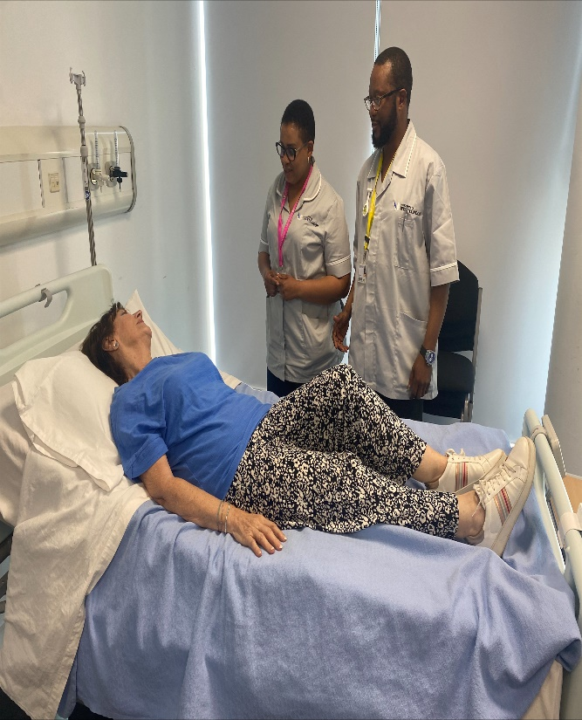
Implications and conclusion
Implications
Practice
Improve practice
Training and education
Expansion of PEeP to other fields of nursing, and other MH cohorts
Research
More research with a bigger sample size is needed
Conclusion
Innovative approach to prepare MH nursing students for practice experience.
Barrier to its implementation: lack of dedicated space, and duration.

Slide 10
References
Health Education England (2022) Commitment and Growth: advancing mental health nursing now and for the future. London: Health Education England
Mitchell, G. (2022) Mental health nursing review warns specialty risks being ‘lost, Nursing Times. Available at: https://www.nursingtimes.net/news/mental-health/ (Accessed: 5 May 2023).
Taylor, L. and Salmon, G. (2021) Enhancing Peer Learning through Online Placements for Health and Social Care Professions, International Journal of Practice-based Learning in Health and Social Care, 9 (2), pp.1-10.

